Slide 1
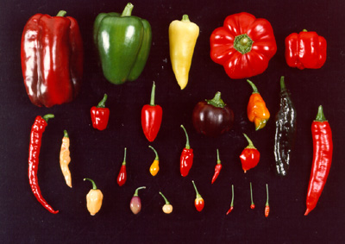
Sources of Variation

Slide 2
What is variation?
Variation refers to an individual that possesses characteristics different from the others of the same kind.
Variation can be measured at the individual level, i.e. differences between individual people, or at the population level, i.e. differences between populations living in different regions.

Slide 3
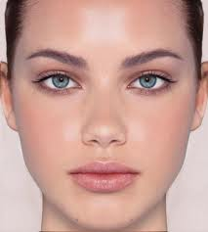
Where does variation come from?
Every living organism has thousands of genes and each gene may have different alleles or affect other genes.
An allele is an alternative form of a gene e.g. blue vs. brown eye colour.
Nematode: 19,000 genes
Human: 23,000 genes
Daphnia: 31,000 genes

Slide 4
What do genes do?
A gene is a length of DNA (a segment of a chromosome) which codes for a particular protein.
That protein determines a particular characteristic.
GENE
Protein
Trait
e.g. Lactase gene - - - - -> Lactase enzyme - - - - - - - - - > Can digest dairy

Slide 5
What do we need DNA for?
DNA is a code which contains all the information to build proteins to make different cells perform different functions.
All the cells in an organism’s body (except sex cells) contain the same DNA….
…..BUT …. each cell only “turns on” the information which relates to its job.

Slide 6
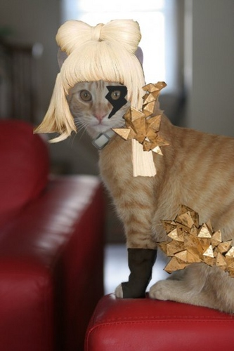
Genome is like a set of Recipe Encyclopaedias
G AC T
DNA is the letters.
Codons are words.
Gene is a recipe.
Chromosome is a volume.
Genome is the whole set.
cat
1. Gag a Gaga
cat.

Slide 7
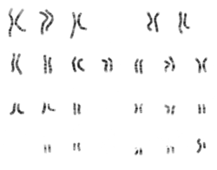
Genome is like a set of Recipe Encyclopaedias
DNA is the letters.
Codons are words.
Gene is a recipe.
Chromosome is a volume.
Genome is the whole set.
GATTATCGGAGTGCGATG
GAT TAT CGG AGT GCG ATG
A enzyme to make digestion faster
A enzyme to make digestion faster; A protein which makes cell blue; A muscle cell; A neuron; A growth hormone

Slide 8
Sources of Variation
Mutations
Meiosis
Sexual Reproduction

Slide 9
Mutations
Read pages 122-126
Write the answers to the blue box on page 126 in complete sentences.
e.g. A mutation will NOT always cause harm to an individual.

Slide 10
Single gene mutations
THE FAT CAT ATE THE RAT
Substitution
These point mutations may not affect functionality because:
there is a second polymerase enzyme to check for mistakes
large amounts of our DNA is non-coding (introns)
codons are redundant (e.g. UUA, UUG, CUU, CUC, CUA, CUG all code for leucine)
THE FAT CAT ATE THE HAT

Slide 11
Single gene mutations
THE FAT CAT HATE THE RAT
Insertion
Deletion
These mutations can affect the reading frame (3 bases = 1 codon)
Frameshift mutations
THE FAT CAT AT_ THE RAT
HEF ATC ATA TET HER AT

Slide 12
Mutation video
http://www.youtube.com/watch?v=efstlgoynlk

Slide 13
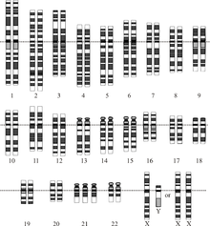
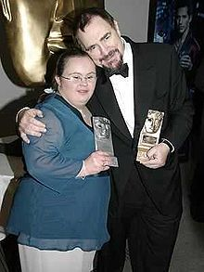
Chromosomal mutations
Non-disjunction
During meiosis, the spindle fibres may fail to separate, meaning the gamete has more or less than one of each chromosome.
Down’s syndrome
People with three copies of chromosome 21 (Trisomy 21).
Down syndrome is associated with a delay in cognitive ability and physical growth, and a particular set of facial characteristics. The average IQ of young adults with Down syndrome is around 50.

Slide 14
Chromosomal mutations
Deletion
Whole genes may be lost if they become unattached to the centromere. The effect depends on how important the lost genes are
Duplication
Genes are duplicated to appear twice in the chromosome. This can be advantageous because no information is lost and new genes are gained.

Slide 15
Chromosomal mutations
Inversion
The order of a section is reversed so the genes appear in the wrong order. This can be harmful or beneficial depending on which genes are inverted.
Translocation
A section of a chromosome becomes attached to a non-homologous chromosome (so, different to duplication). This is often fatal.

Slide 16
Key Points
Mutations are a permanent change in the DNA.
Mutations may be beneficial, deleterious or neutral.
Mutations only enter the gene pool if they are gametic mutations.
Somatic mutations only affect the individual and are not passed on.
Silent mutations may be passed on but not expressed until a change in environment or a combination of recessive alleles occurs.

Slide 17
Mutation Crossword
Across
2 (8)
6 (9)
7 (6)
9 (12)
12 (8)
13 (7)
14 (9)
15 (7)
16 (9)
17 (5,8)
Down
1 (11)
3 (6)
4 (3)
5 (13)
8 (9)
10 (7)
11 (8)

Slide 18
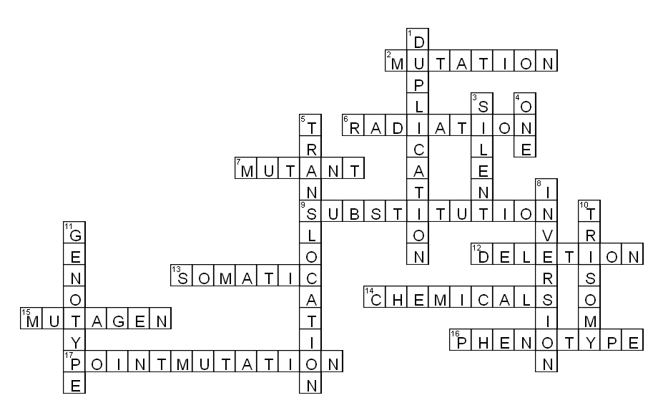
Mutation Crossword

Slide 19
Sources of Variation
Mutations
Meiosis
Sexual Reproduction

Slide 20
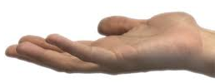
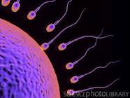
How many chromosomes?
All body cells have TWO sets of chromosomes = diploid
Sex cells (gametes/germ cells) have only one set of chromosomes
= haploid
That means when fertilization
occurs, the new individual will
have the correct number of chromosomes.
MITOSIS!!
MEIOSIS!!
A fertilized egg is called a ZYGOTE

Slide 21
How are gametes created?
We need sex cells for:
Reproduction
All gametes must contain only ONE of each pair of chromosomes in the nucleus.
Sex cells have the haploid number of chromosomes.

Slide 22
Meiosis
Watch the video to identify the steps.

Slide 23
Meiosis Step-by-Step
1 - Chromosomes in the nucleus replicate, shorten and fatten and become visible.

Slide 24
Meiosis Step-by-Step
2 – The nuclear membrane disappears and spindles attach to each chromosome.

Slide 25
Meiosis Step-by-Step
3 – Homologous chromosomes pair up at the equator.
INDEPENDENT ASSORTMENT

Slide 26
Meiosis Step-by-Step
4 – Adjacent non-sister chromatids may swap genes.
CROSSING OVER

Slide 27
Meiosis Step-by-Step
5 – Two new cells form with a different mix of chromosomes.

Slide 28
Meiosis Step-by-Step
6 – The chromosomes then line up in a single line, in each cell.
SEGREGATION

Slide 29
Meiosis Step-by-Step
7 - Each half of the chromosomes is pulled to the side of each cell.

Slide 30
Meiosis Step-by-Step
8 – Each cell begins to separate into two new cells.

Slide 31
Meiosis Step-by-Step
9 – Four new sex cells are produced.

Slide 32
Meiosis
The purpose of meiosis is to produce four non-identical daughter cells that each have the haploid number of chromosomes.
Meiosis increases variation through:
Independent assortment
Crossing over
Segregation

Slide 33
Independent Assortment
Homologous chromosomes are randomly arranged at the cell equator before the first division of meiosis.
Possible combinations are 2^{n}, i.e. if there are two pairs of chromosomes, there are 2² = 4 possible combos.
X
X
X
X
X
X
X
X
X
X
X
X
X
X
X
X

Slide 34
Independent Assortment
If there are 3 pairs, 2³ = 8
X
X
X
X
X
X
X
X
X
X
X
X
X
X
X
X
X
X
X
X
X
X
X
X
X
X
X
X
X
X
X
X
X
X
X
X
X
X
X
X
X
X
X
X
X
X
X
X
How many combinations are there for humans, n=23?

Slide 35
Quick Vocab Refresher
Complete dominance: inheritance where one allele is completely dominant over the other.
Dominant allele: the allele which is always expressed in the phenotype if present in the genotype.
Recessive allele: Masked by dominant if heterozygous, can only be expressed in the homozygous condition.
Heterozygous: one of each allele
Homozygous: both alleles the same

Slide 36
Independent Assortment
Use the cards to model independent assortment.
First draw the parental phenotypes.
Then shuffle the cards for the mother, lie them out in rows of traits, first card for each trait on the left.
Repeat with the father.
Cross the egg and sperm randomly to get their first offspring – draw child number 1.
Repeat for three children.

Slide 37
Crossing Over
When homologous pairs line up, crossing over may occur between adjacent non-sister chromatids.
Crossing over is the mutual exchange of alleles between homologous chromosomes.
It means that two new, unique chromatids are formed, called recombination.

Slide 38
Crossing Over
chromosome
A
B
C
A
B
C
a
b
c
a
b
c
A
B
C
A
B
C
a
b
c
a
b
c
chromatid
centromere
D
E
F
G
D
E
d
e
d
e
f
g
D
E
F
G
D
E
f
g
d
e
F
G
d
e
f
g
chiasma
f
g
F
G

Slide 39
Crossing Over
A
B
C
A
B
C
a
b
c
a
b
c
Write the genes for each of the four chromatids if crossing over happened at chiasma:
1
2
3
2 & 3 – tricky!
Hint: start from the centromere
1
D
E
F
G
D
E
F
G
d
e
f
g
d
e
f
g
2
3

Slide 40
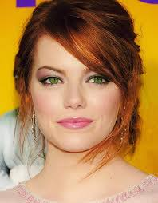
Crossing Over
Crossing over increases variation even more because it creates new combinations of genes which can be passed on together.
For example, if red hair and green eyes were on the same chromosome they would always be passed on together.
BUT with crossing over, these linked
genes can be separated e.g. red hair
+ blue eyes, black hair + green eyes.
We will learn the importance of linked genes later!

Slide 41
Segregation
If crossing over occurs, the chromatids are no longer identical.
This means that at the second division of meiosis (splitting chromatids), more variation occurs because the orientation of each chromosome along the equator is random.
VS.

Slide 42
Sources of Variation
Mutations
Meiosis
Sexual Reproduction

Slide 43
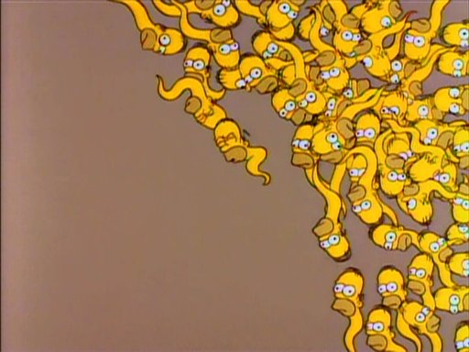
Sexual Reproduction
Random mutations and independent assortment, crossing over and segregation during meiosis all combine to produce gametes which are unique from each other.

Slide 44
Sexual Reproduction
In human females, approximately 1 million immature eggs are already formed at birth.
400,000 follicles remain by the time girls reach puberty.
With each ovulation, 1 in 1000 eggs matures while the others die.
In total, only 400-500 mature eggs will be produced in a woman’s life cycle.
Meiosis occurs in phases – only completed upon sperm entering the egg.

Slide 45
Sexual Reproduction
In human males, meiosis does not start occurring until puberty.
Spermatogenesis takes 74 days.
Testes produce 200 to 300 million sperms daily.
A single ejaculation contains, on average, 255 million sperms.

Slide 46
Sexual Reproduction
Every fertilisation is random!
For example, the likely proportion of offspring sex look likes this:
1 male : 1 female
BUT you only expect to approach that ratio if you repeat the observation many, many times (i.e. if a pair has thousands of offspring).
How does the sex ratio in your family/extended family look?
 | X | X
X | XX | XX
Y | XY | XY

Slide 47
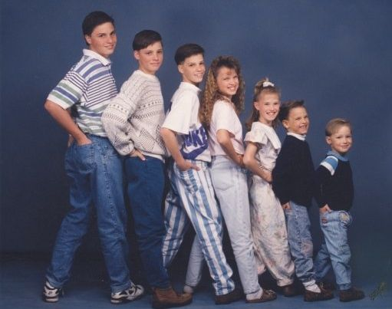
Sexual Reproduction
All these sources of variation contribute to the physical differences between siblings and increase the variation in the gene pool.

Slide 48
Meiosis Question
Find the TWO parts of the question.
What is the maximum mark for this question?
If you forgot what a gamete was, what hints are there to help you?
Links – what do you know about meiosis to help you answer this question?
Sentence starters on board.

Slide 49
Meiosis Question
For achieved:
Gametes are sex cells e.g. sperm, egg
Gametes have half the number of chromosomes
For merit:
Gametes are needed so that when sperm and egg fuse (sexual reproduction) the first cell of the new organism (zygote)has the correct number of chromosomes.

Slide 50
Meiosis Question
What is the question worth?
What is your plan?
What else do you need to do?

Slide 51
Meiosis Question
What hints are there?
Which diagram could help your answer?
Can you think of examples to include?
Sentence starters on board.

Slide 52
Meiosis Question
For Achieved:
Genetic variation is variety of phenotypes/alleles/versions of a gene in a population
Meiosis creates variation by randomly separating pairs of chromosomes.
Variation is beneficial to a population is conditions change.
2 out of 3

Slide 53
Meiosis Question
For Merit:
Meiosis separates pairs of chromosomes so new combinations of alleles can occur in a population when sperm and eggs meet (fertilization).
Variation might allow individuals to survive if the environment changes and to pass that ability on to offspring.
1 out of 2

Slide 54
Meiosis Question
For Excellence:
Genetic variation within a population is important for the survival of the species because inherited variation is constantly being generated by the process of meiosis, through the reshuffling of alleles.
LINKS all 3 ideas:
meiosis -> variation -> population

Slide 55
The diagram
Making it clear what you mean when you talk about meiosis.
How could this diagram be better?

