Slide 1
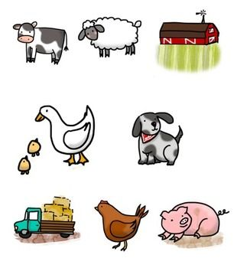
Reproductive Techniques
What we’ve looked at so far
Reproductive systems
Hormone cycles
Estrus detection
Estrus synchronization
Artificial lighting
Artificial hormones (CDIR)
Teasers

Slide 2
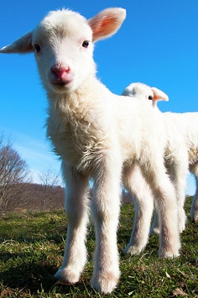
Fertility
Fertile animals are those that most
efficiently reproduce. They successfully
raise healthy offspring.
Fertility is affected by:
Time of year
For sheep, fertility peaks in autumn.
Breed
Some breeds are more likely to produce twins.
Disease
Fever can make males infertile, brucellosis can cause abortions.
Diet
Dams with not enough feed or who are too fat are less fertile.

Slide 3
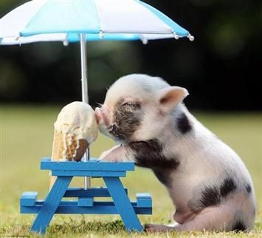
Flushing
Flushing is the practice
of putting animals onto
good feed some weeks
before they are due to be mated in order to
increase fertility.
In this way, farmers can save costs on expensive feeds while ensuring the best chance of reproductive success.

Slide 4
Protein
Protein is a limiting macronutrient because it is sparse in herbivore diets (meat is mostly protein).
Animal | Protein needs (% in feed)
Young chickens | 22
7wk chickens | 20
Laying hens | 15
Non-laying hens | 7
Store sheep | 6
Fattening sheep | 10
Cows in full milk | 15
Dry cows in calf | 10
Growing pigs | 16
Horses in old age | 6
Food | Protein content (%)
Linseed meal | 31
Prime lucerne hay | 13
Fair lucerne hay | 10
Poor lucerne hay | 8
Wheat grain | 10
Prime oat hay | 5
Good grass pasture | 5
Old dry native grass | 2
Oat straw | 0.7

Slide 5
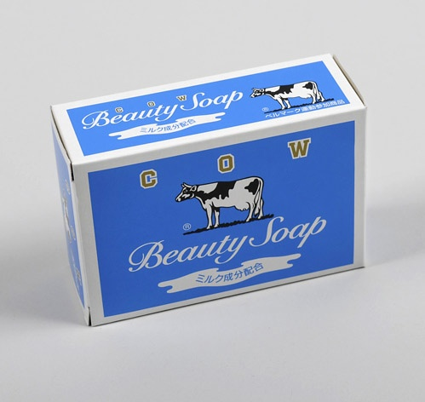
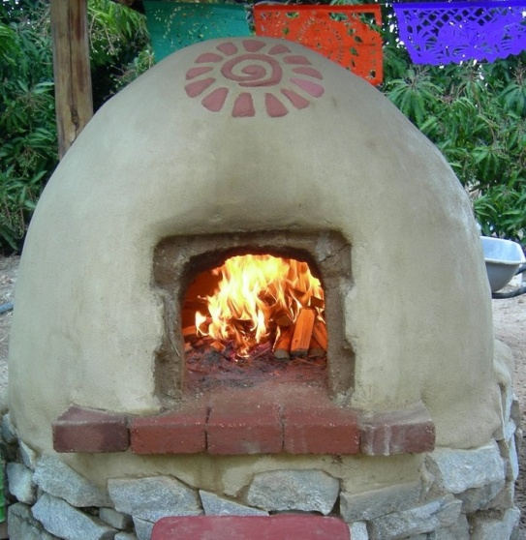
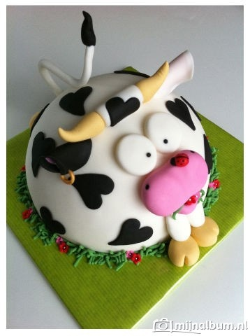
Genetics
Every organism is a product of its genes and its environment.
GENES
ENVIRONMENT
Ingredients

Slide 6
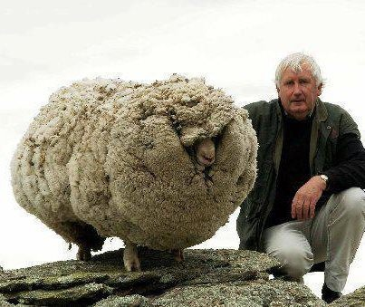
Genetics
Many of the traits which farmers
want to increase in their stock
(e.g. disease resistance, fertility, milk
production, wool growth, twin-bearing, weight)
are partly controlled by the animal’s genes.
This means farmers can selectively breed good animals to increase the likelihood of the next generation having better traits.
This keeps the herd improving and the farm productivity and profitability increasing.

Slide 7
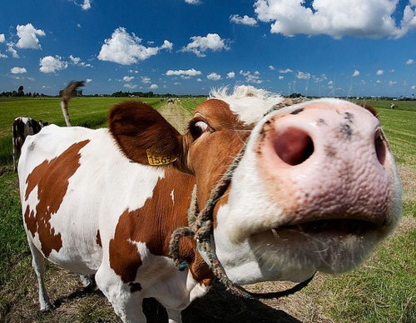
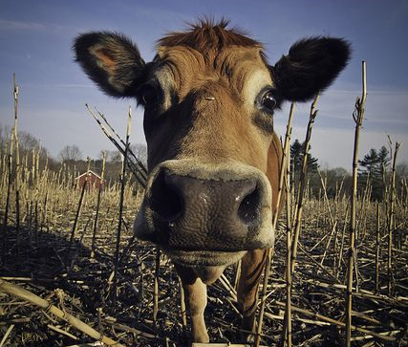
Genetics Case Study
Rose
317 kg dairy cow
4.5 L milk/day
15 kg food intake
3.3 kg food/L milk
Violet
317 kg dairy cow
13 L milk/day
25 kg food intake
1.9 kg food/L milk
Which cow would you breed?

Slide 8
Mendelian Genetics
Some traits, such as coat colour, are the result of a single gene.
Every organism carries two copies of each gene, called alleles.
At fertilisation, one allele from each parent is combined in the new organism.
Alleles may be dominant (always shown in the phenotype) or recessive (only shown in the absence of a dominant allele).

Slide 9
Mendelian Genetics
In cattle, hornless (H) is completely dominant over the horned condition (h). A horned (hh) bull is bred with a hornless (HH) cow. What will the offspring phenotype be?
H
H
h
Hh
Hh
h
Hh
Hh

Slide 10
Mendelian Genetics
In cattle, hornless (H) is completely dominant over the horned condition (h). A horned (hh) bull is bred with a hornless (Hh) cow. What will the offspring phenotype be?
H
h
h
Hh
hh
h
Hh
hh

Slide 11
Mendelian Genetics
In cattle, hornless (H) is completely dominant over the horned condition (h). A hornless (Hh) bull is bred with a hornless (Hh) cow. What will the offspring phenotype be?
H
h
H
HH
Hh
h
Hh
hh

Slide 12
Genetics
Unfortunately, while coat
colour, horns, hair length
and spottiness may be controlled by a single
gene, most traits are the result of a
combination of genes and produce a
spectrum of phenotypes.
Therefore, farmers must try to choose the best gene combinations possible and hope that they are expressed in offspring.
For example, some great milkers may not pass the gene to their daughters.

Slide 13
Embryo Transfer (MOET)
Multiple ovulation & embryo transfer
Prime females are given hormones to “super-ovulate”, meaning they produce more viable eggs.
Five days later the cow is artificially inseminated with prime donor sperm.
One week later the embryos at the 2-8 cell stage are removed with a foley catheter (non-surgical removal).
5-6 embryos are recovered.

Slide 14
Embryo Transfer (MOET)
Each embryo is then classified and separated under a microscope.
Embryos may be directly implanted in a surrogate female or stored frozen for later use.
After several weeks, the surrogate cow will be checked for pregnancy.
After nine months, several different cows give birth to sibling calves with excellent genes.

Slide 15
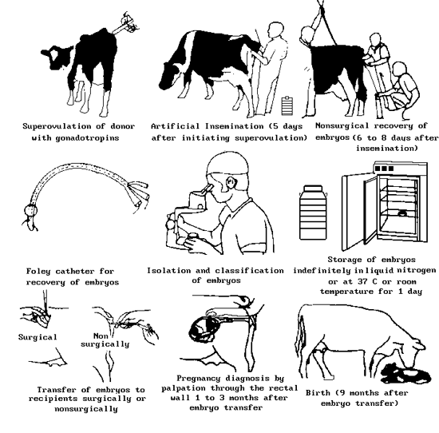

Slide 16
TVR-IVP
Trans-vaginal Recovery
Ultrasound-guided suction needle removes 7-8 eggs from the ovaries.
Only takes 15 minutes
In-vitro Production
Eggs mature overnight in culture
Eggs are fertilised the next day with choice sperm and given one week to develop into embryos.
1-2 embryos will develop to transferable embryos with a 50% chance of pregnancy

Slide 17
MOET vs. TVR-IVP
www.abreeds.co.nz – see for fees

Slide 18
Artificial Insemination
http://www.youtube.com/watch?v=2yvXowLh-Pg
Visit sites such as crv4all.co.nz (AmBreed) to see the types of qualities top bull sperm donors possess.
Complete page 32.

Slide 19
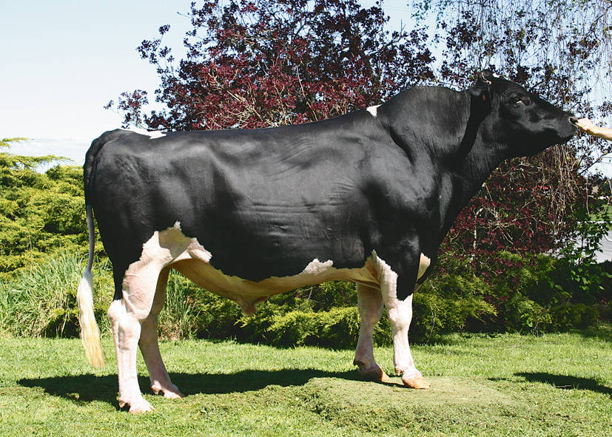
Bull Genetics
Read the article on page 29 and complete the questions beneath.
Fluke, one of Hibi Secret Skelton’s sons and now one of CRV’s available donors.
www.ambreed.co.nz
Protein BV | 26
Milk BV | 660
Overall Opinion | 0.3
Capacity | 0.51
Rump Angle | 0.03
Udder Overall | 0.44
Live Weight | 59
Fertility | 2.5
Somatic Cell | 0.2
Residual Survival | -28
Calving Difficulty | 5.7

Slide 20
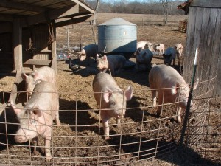
Pen & Hand Mating
Pen-mating means that, ideally, a cohort of females is brought into the boar's pen and he services them all while they are in the pen. This is the least labor-intensive mating system because the pigs are just left to mate at will. In addition, even though the sows are better stimulated by entering the boar's environment, the boar is often brought to the females' pen to save on labor.
Pen -mating is the least efficient use
of boar power, or boar use efficiency.
Sows may be mated which do not need
to be (already conceived). And so-called
pregnancy wastage is higher due to
"social competition."

Slide 21
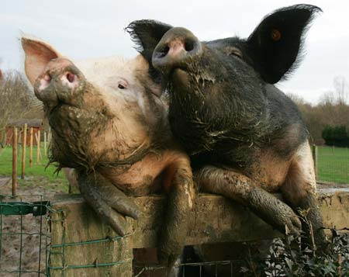
Pen & Hand Mating
Hand-mating means that the boar and one sow (or gilt) at a time are brought together for servicing. Not only does this allow the producer to choose who gets mated and eliminate social competition, it also allows for better timing of the servicing in order to allow
the boar's fertility to be at its
peak with each subsequent
mating. Hand-mating has a
higher labor requirement than
does pen-mating.

Slide 22
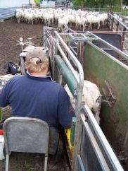
Scanning
Just like pregnant human women, ultrasounds can be used to detect pregnancy.
This can tell farmers if stock are pregnant and how many offspring they carry.
Farmers use this information to make management decisions about feed/sale etc.

Slide 23
Scanning
Scanning is performed 1-3 months after mating so that the fetus is large enough to be seen.
Scanning technicians visit the farm with their equipment, including a viewing screen, and usually scan individual animals restrained in cages, yards or tied-up.
Scanning is a harmless, though potentially expensive, procedure so is only of use to farmers with low offspring percentages.

Slide 24
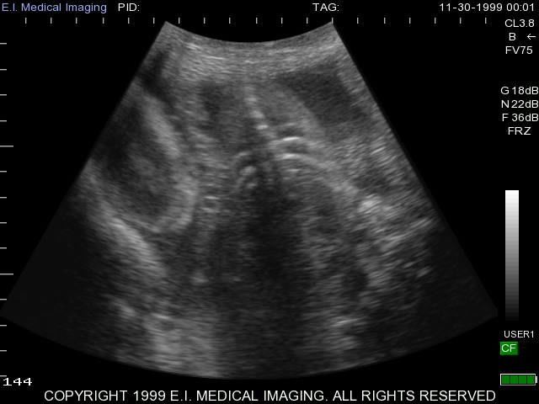
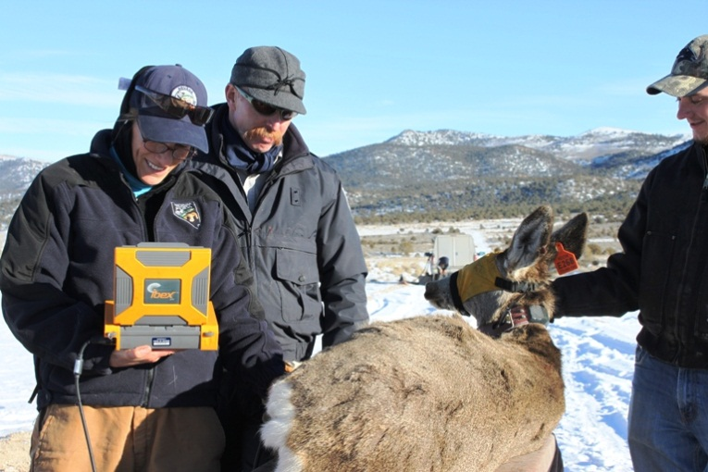
Scanning

Slide 25
Inductions
Induction is the process of artificially causing an animal to prematurely give birth.
As a result, the offspring usually dies.
Reasons for inductions may include:
Late breeder (synchronizing milking)
Small heifer with large calf
Fetal abnormality detected by scanning

Slide 26
Inductions
Induction is a very controversial management decision, which has received much attention from animal rights groups.
Fonterra is committed to no more than 4% inductions per herd.
Witnessing and disposing of induced calves can be a distressing procedure for farmers.

Slide 27
Environmental Control
In a groups, try to come up with ideas for the table on page 38.
Example: Wind prevents frosts settling but it could also chill livestock, which could be lethal for newborns.
Solution: Grow trees as a wind-break to provide shelter for stock while they are lambing/calving.

Slide 28
INTERNAL 2.5
Part One:
DESCRIBE three procedures (in detail) with reference to reproductive systems/structures.
Part Two:
GIVE REASONS for the steps and how they influence the success of the technique, with reference to reproductive systems/hormones
Part Three:
JUSTIFY the usefulness of the technique for farmers e.g. labour, quantity, cost, timing.

