Slide 1
NZ Sheep Industry
Presented by Courtney and Tammie.

Slide 2
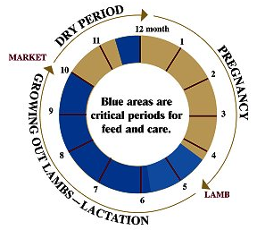
Production Cycles
Critical care includes:
Shearing
Crutching
Dipping
Drenching
Tailing
Vaccinating
Flushing
Weaning

Slide 3
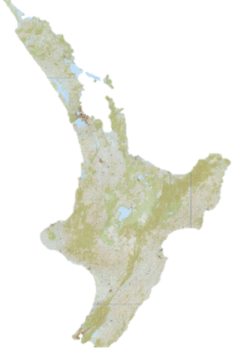
Land
Sheep farming can be done on most land, high country, river flats and rolling hills.
All of NZ’s topography can be used in sheep farming with the use of different breeds and how their farms are run.

Slide 4
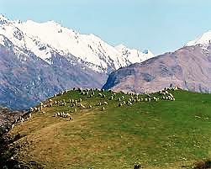
High country
Differs from high mountain tops with none or little soil fertility to low fertile valleys.
Farms generally run merinos or half-breeds and their main income is fine wool and lamb sales.
Land is mainly untouched and just grows what is already there like tussock and brown top which are some of the better more fertile areas used for crops, hay or silage to use the following winter.

Slide 5
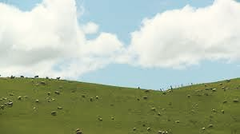
Hill country
Most of NZ’s sheep are ran on hill country.
Farms tend to run Romney's in the North Island but the South Island tends to run half-breeds or corredales in the dryer areas and Romney’s in the wetter.
Can be spilt up into three main types of hill country by how steep the hills are:
Hard hill country the main income is wool and store sales.
Medium hill country they fatten lambs and old stock for meat and wool is also big.
Easy hill country is easier to manage and breed stock is also easier for the farmer to get machinery around. This type is good for breeding stock and improving stock productivity stud sheep and rams are usually run on this type of country.

Slide 6
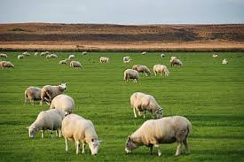
River flats
Can be intensively sheep farmed and have been for years in NZ although dairy is also up with that.
Sheep farmers plant crops on the river flats to feed stock they may have been on hard hill country to finish them off.
Stud farmers also use river flats.

Slide 7
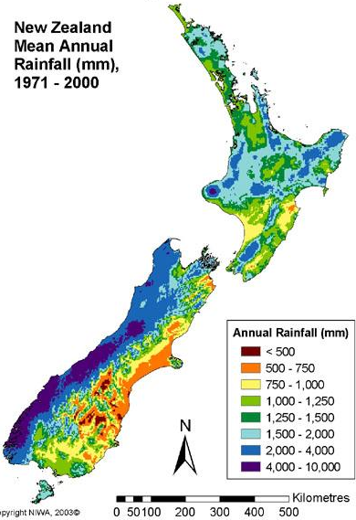
Climate
The climate is harsh with long winters with very low temperatures and snow that can last for months to hot dry summers.
Heavy snowfalls can cause a huge loss in stock numbers depending on how deep and how long the snows stays around.

Slide 8
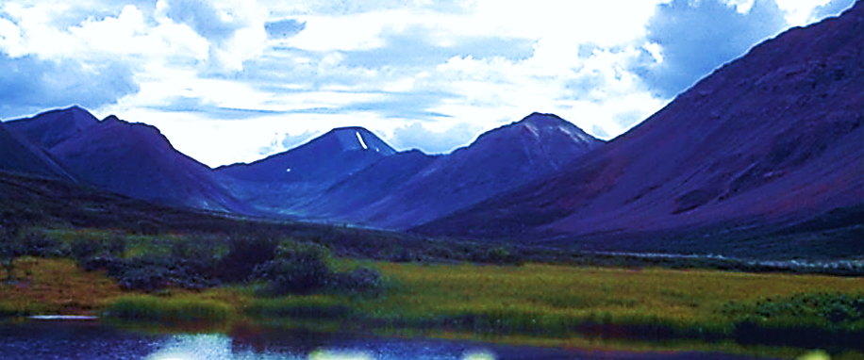
Environment
Farming has got an impact on the environment, here are some things that will harm the environment:
Chemicals could leak or spill killing crops.
Cultivation could cause more erosion along the banks of a river or stream.
To much fertiliser could leach into a near by river or stream.
The silage wrap can’t biodegrade, so some farmers burn it to get rid of it. Recently there has been efforts to recycle it but this is hassle.
Stock grazing could cause soil and water erosion.
Some farmers manage waste by burning it but burning is bad for the environment and causes pollution in the air.
Taking water from waterways, water logging or leaching on nutrients from soils could cause an algae bloom.

Slide 9
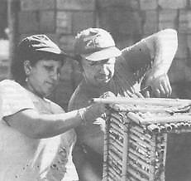
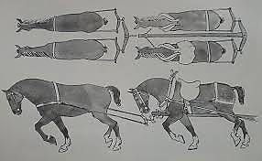
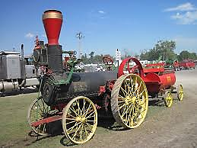
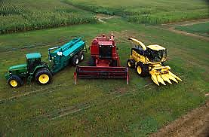
Technology
Farming technology has changed over time dramatically in all aspects, from machinery to breeding technologies and disease prevention.
Some changes are:
Manual Labour, Horse and Cart have changed to Tractors, Trucks, Ploughs, Sowers, Harvesters, Cultivators, Aerial topdressings and Motorbikes.
Even Hand Shears have changed to machine and electric shears.
The science side of the industry has changed now farmers are able to use their knowledge in farming and genetic material to help improve breeding quality.
Improvement in antibiotics and the prevention of diseases lead to healthier stock and sheep live longer.

Slide 10
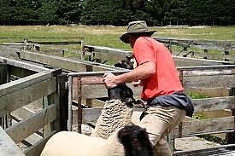
Work
The qualifications you need for sheep farming are:
National Certificate Level 3, 48 Credits this includes variety of tasks, including raising and caring for livestock, repairs and maintenance, tractor work, and other farming activities.
There was about 23,245 sheep farmers all over NZ in 2012.
For 1 to 3 yrs you could get $28k-$40k or for 3+ yrs you could get $40k-$60k.
Chances of getting a job as a sheep farmer are good due to high demand for farmers.

Slide 11
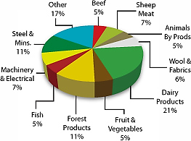
Economy
Sheep farming has been crucial in the development of New Zealand’s economy.
The export returns from fine wool provided the drive for economic growth.
The frozen meat industry created new opportunities for sheep farmers.
Sheep numbers peaked at 70.3 million in 1982 but have fallen since to around 39 million in the early 2000s.
However, New Zealand remains the world’s largest exporter of sheep meat and cross breed wool.
In 1920 wool contributed 26 percent of the total value of exports but by 2011 wool's contribution to the value of exports had fallen to 1.6 percent.

Slide 12
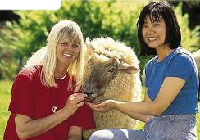
Society
Life for sheep farmers can be:
Stressful when droughts or floods come unexpectedly.
Hard on health.
Society reacts to sheep farmers by:
Tourist love farm animals.
Can be loyal sometimes.
Each farmer prefers their kind of landscape.

Slide 13
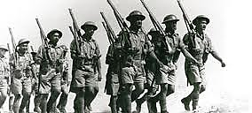
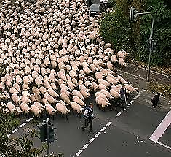
Political
Early European land settlement. For European, as for Maori, land ownership was the most important political issue in New Zealand during the 19th century.
Farmer and grower organisations for farmers and other rural people provided social networks, a political voice, opportunities for sharing knowledge, and help in hard times. Some groups are for farmers of particular animals or crops, and there are others for rural women and young farmers.
So far there is no foreign ownership in sheep farming.
Health scares become an issue according to the government.
There is little or no carbon/methane emissions with sheep farms.
Genetic modification isn’t allowed for sheep.
There are rising debates about animal welfare but most sheep farmers look after their stock.

