Slide 1
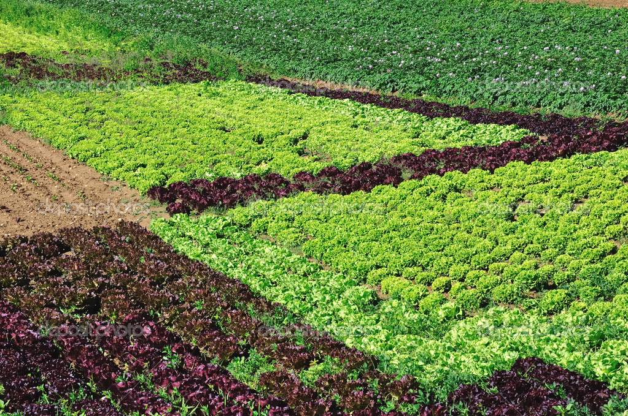
Market Gardening
Production of fruits, vegetables or flowers on a commercial scale.

Slide 2
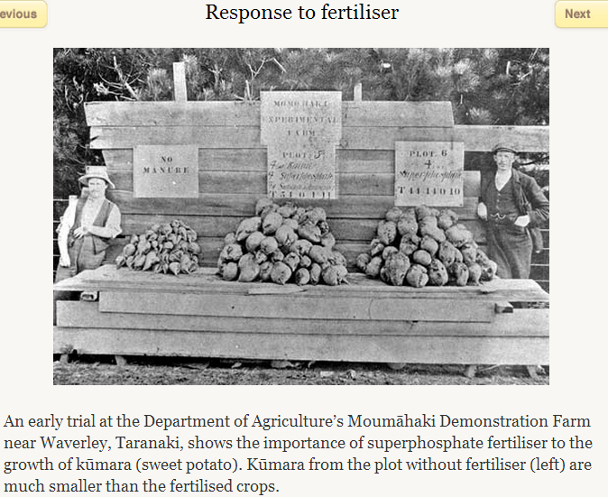
Fertiliser

Slide 3
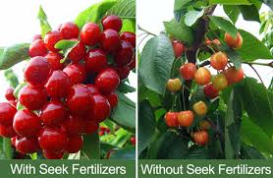
Fertiliser

Slide 4
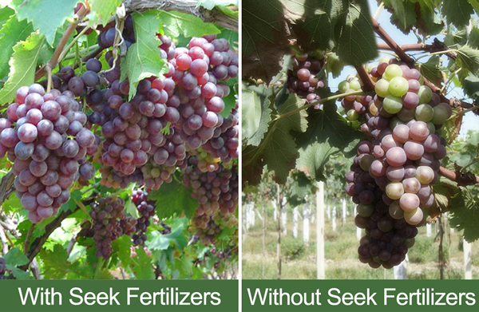
Fertiliser

Slide 5
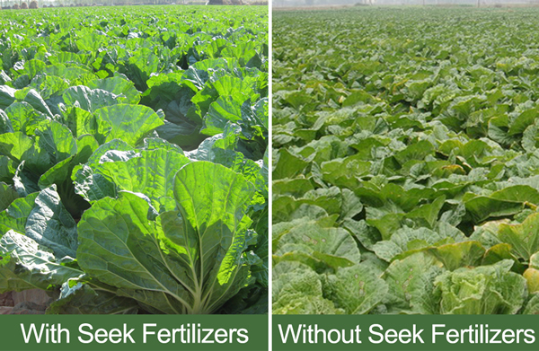
Fertiliser

Slide 6
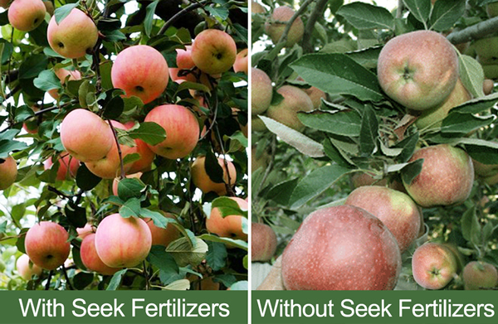
Fertiliser

Slide 7
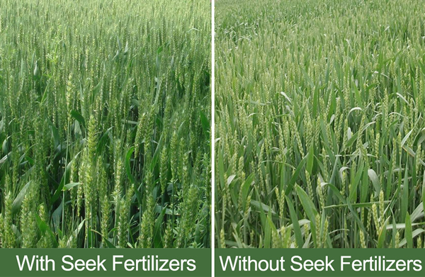
Fertiliser

Slide 8
Economy
The major fruit grown commercially are apples (especially in Hawke’s Bay), kiwifruit (Bay of Plenty), grapes and avocados (Bay of Plenty and Northland). In the years 1975–2000 there was an increase of over four times in the number of trays of pip-fruit exported. Fruit, nut and vegetable exports made up 3% of total exports, the most important component being kiwifruit, followed by apples, legumes and onions.

Slide 9
Economy
This graph shows the value of exports of vegetables, cut flowers, seeds and bulbs between 1965 and 2005. Dollar values have been adjusted for inflation to 2005 levels. These exports form a significant and increasing component of New Zealand's horticultural trade. Although there has been a small export trade in vegetables from New Zealand since the 1800s, modern export markets have only been developed since the mid-1980s.

Slide 10
Economy
Kiwifruit exports account for 46% of all horticultural exports.

Slide 11
Economy
Kiwifruit PSA

Slide 12
Economy
Despite PSA, the industry is aiming to expand to $3 billion from exports by 2025.
SQ = Status quo, AR = assisted recovery, UR = unassisted

Slide 13
Economy
Vegetable production is a multi-million-dollar business in New Zealand, worth NZ$1,456 million in 2007. Domestic production accounted for about 60% of the value of the industry. Export of fresh and processed vegetables earned $566 million in 2007

Slide 14
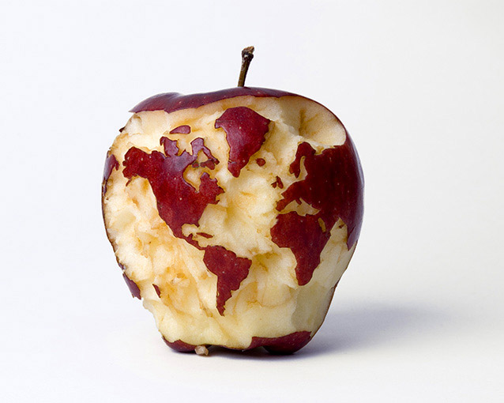
Economy
Where does the product go?
See the poster at the back of the class

Slide 15
Economy
Pay
Pay for crop farmers varies widely depending on the:
size of the farm
type of crops grown
profitability of the farm, which may vary from season to season
prices received for the crops.
A Ministry for Primary Industries farm monitoring report for the 2011-2012 financial year found that:
the average profit for Canterbury arable farms was $270,000
the average profit for pipfruit orchards was $33,000
the average profit for vineyards was $81,000
kiwifruit growers' average profit was $55,000.

Slide 16
Technology
Sort the farm machinery into their respective rolls e.g. cultivators, sowers, harvesters.
Then try to decide within groups the order in which these technologies have been developed.
What did early farmers (pre-tractors) use for each task?

Slide 17
Technology

Slide 18
Technology

Slide 19
Technology
Aims of bio-engineering include:
Herbicide resistance
Pest resistance
Disease resistance
Food enhancement
Stress resistance (i.e. require less water)
Pollutant elimination (e.g. plants that can remove heavy metals or petroleum products in soil)

Slide 20
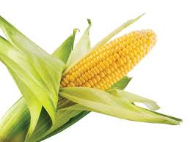
Technology
Genetically modified maize (corn) is a genetically engineered corn plant with agronomically desirable traits.
Corn that is resistant to herbicides has been developed, as has corn that expresses insecticidal proteins from Bacillus thuringiensis bacteria.
While it has been widely adopted by farmers in countries where it has been approved, it has also caused controversy with respect to possible effects on health, non-target insects, and other plants via gene flow.
One strain, called Starlink, was approved only for animal feed in the US, but was found in food, leading to a recall in 2000.

Slide 21
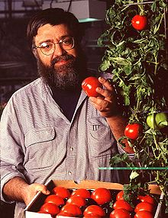
Technology
Flavr Savr tomato
First commercial GM product for human consumption.
Contains an extra gene which interferes with the production of the enzyme which degrades pectin. Pectin keeps fruit firm, making Flavr Savrs more resistant to rotting.
Future pathways include the plant expressing RNA which interferes with protein synthesis in insects, nematodes and other parasites, thus protecting it from pests.

Slide 22
Technology

Slide 23
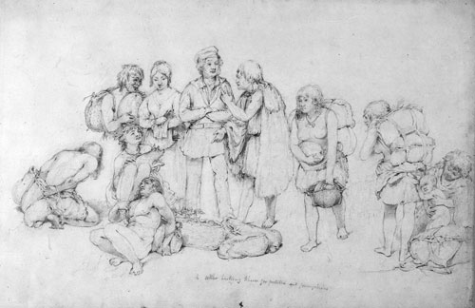
History of Market Gardening
Māori had extensive gardens in New Zealand and became the first commercial growers of vegetables. They traded potatoes with European whalers and traders in the first decades of the 19th century and exported tonnes of potatoes to Sydney in the 1830s. In the 1840s Māori in the North Island also grew maize, tobacco, wheat, cabbage and turnips, and supplied fresh produce to the developing settlements of Auckland, Wellington and Nelson.
European settlers established their own vegetable gardens from the 1840s as Māori began to lose fertile lands into European ownership. Merchants like William Brown and John Logan Campbell entered the export trade, sending potatoes and onions to Australia and the Pacific Islands.

Slide 24
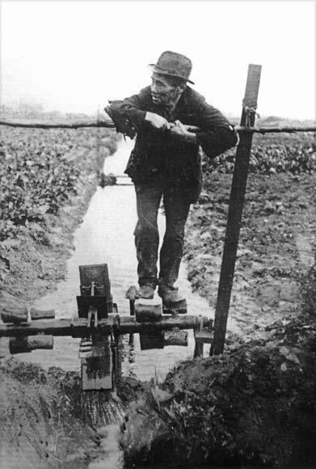
History of Market Gardening
Between 1880 and 1913 sons and young male relatives of Chinese gold prospectors took up market gardening as Otago’s goldfields became exhausted. They settled throughout the country, leasing land, often from Māori. They usually worked in kinship groups and sold their produce to relatives running greengrocery businesses.
A Chinese market gardener in South Dunedin operates a waterwheel to irrigate his cultivated fields.

Slide 25
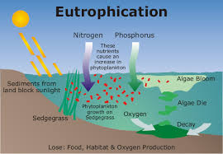
Environment
Nutrient leaching is bad for the environment because it can cause eutrophication. Eutrophication depletes oxygen in water and decreases water quality.

Slide 26
Envirnoment
Nitrogen leaching

Slide 27
Environment
Nitrogen Management

Slide 28
Environment
Phosphorous management

Slide 29
Environment
What environmental effects have large-scale irrigation had?

Slide 30
Labour
Skills and knowledge
Crop farmers need to have:
knowledge of how to grow and harvest various types of crops
knowledge of crop diseases, weeds and pests, and how to control them
understanding of climate and weather conditions, and how they affect crops
knowledge of soil and crop rotation, and cultivation and harvesting methods
understanding of food safety, market certification, and quality requirements
knowledge of health, safety and employment regulations
the ability to recruit, train and manage staff.

Slide 31
Labour
Entry requirements
There are no specific entry requirements for becoming a crop farmer, apart from experience in horticulture or crop farming. However, a diploma or degree in agriculture, horticulture, commerce, or farm management is recommended. A National Certificate in Rural Staff Management (Level 3) may help those farmers employing staff.
A heavy vehicle driver's licence or fork-lift licence can also be useful.
People starting out can also train by doing an apprenticeship.

Slide 32
Labour
Agriculture, horticulture, forestry and fisheries employs more than 146,000 New Zealanders.
The working week was generally 44 hours for dairying, 31.2 hours for sheep and beef and 38.5 hours for grain and seed farming and services.
Over one third of employees were employed for less than one year and short lengths of employment were mostly in junior positions.
About 86 per cent of farm workers are New Zealand citizens with migrant labour higher for dairying positions.
Accommodation is provided for 78 per cent of employees, up by about 3 per cent from last year.

Slide 33
Labour
Salary packages including benefits:
Dairy assistant - $39,803
Dairy assistant herd manager - $46,256
Dairy herd manager -$56,061
Dairy farm manager - $70,336
Dairy operations manager - $69,323
Sheep and beef general hand - $41,981
Sheep and beef shepherd - $46,902
Sheep and beef head shepherd - $55,526
Sheep and beef stock manager - $55,770
Sheep and beef farm manager - $66,740
Arable tractor/machinery driver - $47,652- $55,818
Arable farm manager - $66,359

Slide 34
Social
Working conditions
Crop farmers:
usually work between eight and 10 hours a day. During peak seasonal harvest and planting times they work longer hours, including weekends, and may also be on call
work outdoors, or in glasshouses, nurseries, packing sheds or offices
work in all weather conditions, with machinery and chemicals that can be dangerous
may have to travel between crop fields, to markets or suppliers. They may also travel locally or overseas to attend seminars or conferences.

Slide 35
Social

Slide 36
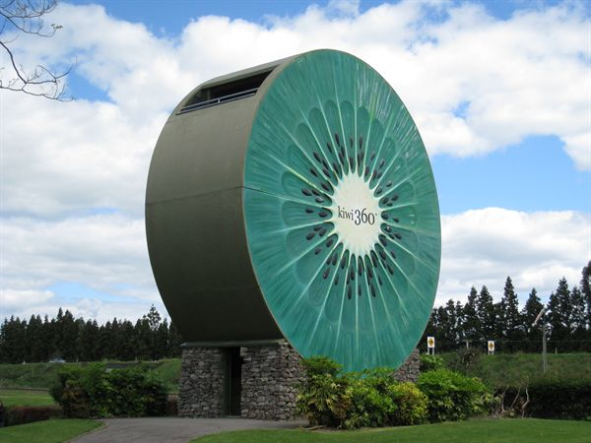
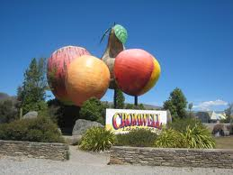
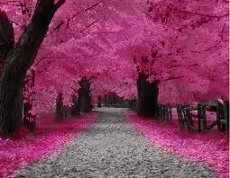
Social
What do you think locally grown produce adds to our kiwi identity?
How else can market gardening add to the appeal of our country?

Slide 37
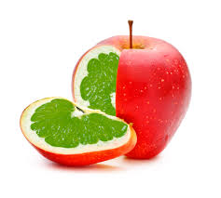
Political
GMO debate
No genetically modified crops are grown commercially in New Zealand. No fresh fruit, vegetables or meat sold in New Zealand is genetically modified. However, some processed foods may contain approved genetically modified ingredients that have been imported. For example, many soy-based products are derived from genetically modified soya beans.

Slide 38
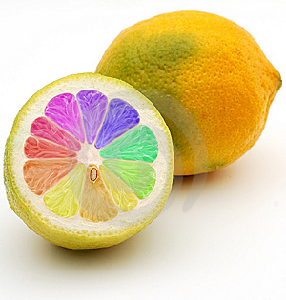
Political
GMO Debate
Genetic modification (GM) involves
moving, inserting or deleting genes
(the part of the cell that determines individual characteristics) within or between species.
GM in New Zealand is strictly controlled through the Environmental Risk Management Authority (ERMA). ERMA operates under strict laws, in line with the Government's cautious approach to GM. It considers each application on its merits and can approve an application only if benefits outweigh risks.

Slide 39
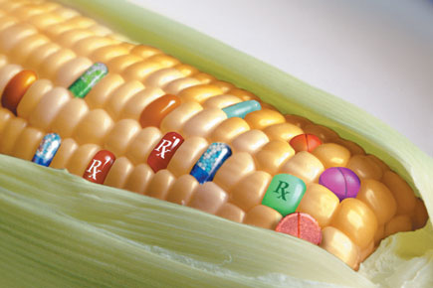
Political
The GM rules are designed to allow New Zealanders to enjoy the opportunities of organic and conventional agriculture, while at the same time not closing the door to the contribution that GM may make to our way of life (especially medicinal and therapeutic).
GM is used in New Zealand for research and education, with much of the research being medical (eg, investigating treatments for multiple sclerosis or cystic fibrosis).
Any food that is genetically modified or contains genetically modified material must be approved as safe by Foods Standards Australia New Zealand and must be clearly labelled.

Slide 40
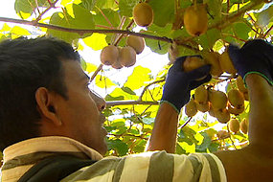
Political
Illegal workers
Read the article on illegal workers and make a list of good and bad effects on the economy, politics (especially international) and society in New Zealand.

Slide 41
Political
Biosecurity
How did PSA get through?
http://www.youtube.com/watch?v=LTq680tNmfU
High profile campaigns are underway against:
Didymo
Coco peat
Sea spurge
Mediterranean/Queensland fruit fly
Gum leaf skeltoniser

Slide 42
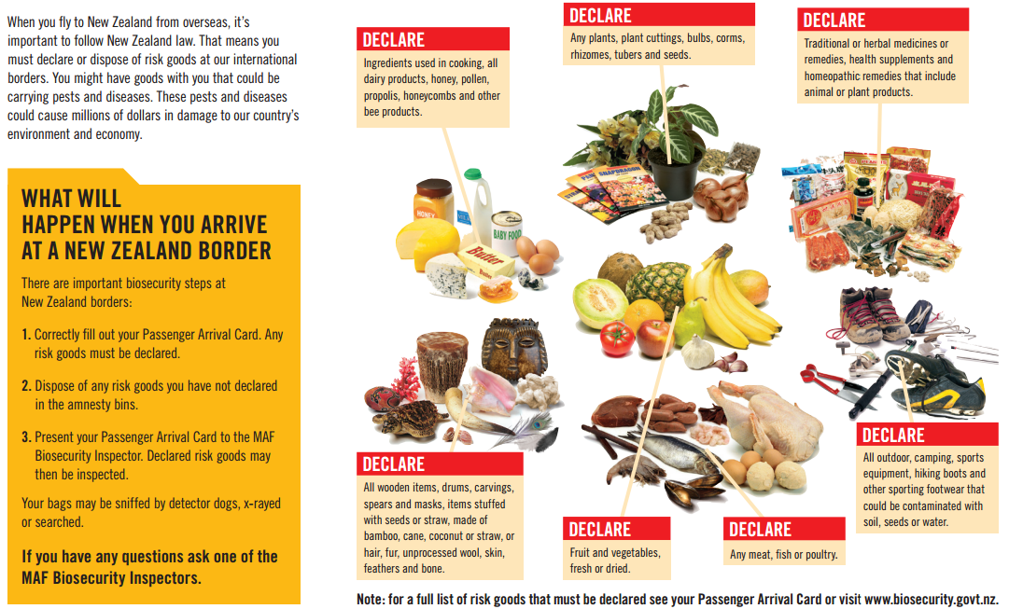
Political

Slide 43
Summary
On your market gardening double-page, make simple notes on things would you discuss for each sub-topic.
Sub-topics:
Climate & land
Production cycles
Economy
Technology
Environment
Politics
Social
Labour
e.g. Environment
Run-off of nitrogen and phosphorous bad
Eutrophication
Economy
Worth 3.6bil in exports
Kiwifruit most valuable
Horticulture outlook good

