Slide 1
What factors affecting the time of breeding?

Slide 2
Breeding cycles
Some animals can breed all year round.
Cows are in estrus every 21 days when not already mated. Chickens can also breed year-round.
Some animals only mate in certain seasons.
Horses, sheep, goats and deer have a breeding season.
What are the advantages and disadvantages of each strategy?
Are males or females more likely to be affected?
Notes:
Horse birthday -

Slide 3
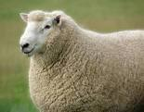
Breeding seasons
Summer Autumn Winter Spring
What cues tell each animal to ovulate?

Slide 4
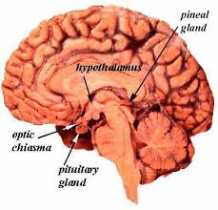
Melatonin
Melatonin is a hormone produced by the pineal gland.
It is called the “hormone of darkness” because it is secreted in the absence of light.
Melatonin cycles control the sleep-wake daily (circadian) rhythms as well as seasonal rhythms e.g. coat growth, coat colour, migration and mating.

Slide 5
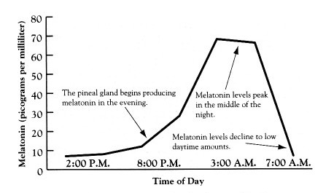
Melatonin
It has been suggested that the hormone changes from child to adult results in delayed melatonin production in teenagers, causing naturally late sleeping and waking.

Slide 6
So how can we use this information to manage reproduction?
Artificial lighting
Synchronised breeding
What are the benefits of synchronised breeding for a farmer?

Slide 7
How do we know if a cow is in heat?
YouTube video from Ohio State University
Complete the table on page 23.
Notes:
http://www.youtube.com/watch?v=sS6eD6iJJIw

