Slide 1
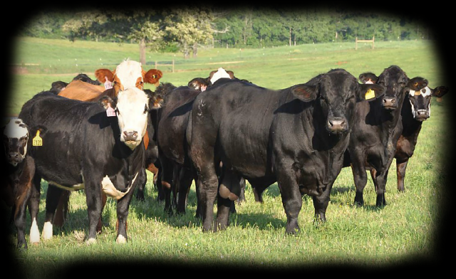
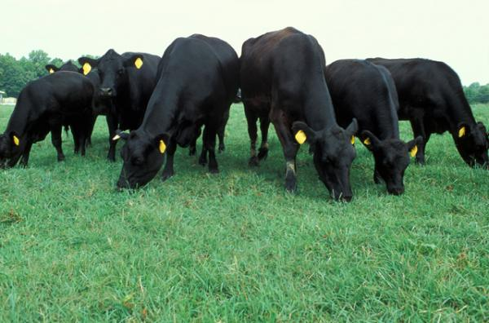
ANDREW AND OLLIE’S BEEF PRESENTATION
PRESENTED BY OLLIE AND ANDREW

Slide 2
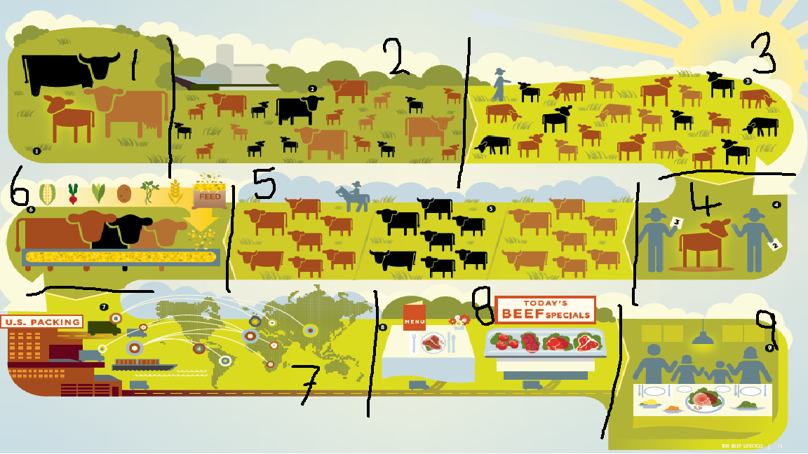
Production cycle of beef cattle
Bull and heifer beginning mating
Multiple offspring due to mating
Calves being fed up ready to be weaned
Weaned calves sold at the local sale
Farmers calves turn into yearlings
Fed up on supplements ready for slaughter/export
Food goods exported around the world
Beef on sale at supermarkets
Happy family enjoying a nice roast beef on a Sunday evening

Slide 3
WHAT ARE THE SUITABLE LAND AND CLIMATE CONDITION FOR BEEF CATTLE?
Suitable land and climate conditions for beef cattle are:
Land- Preferably rolling hill country to flats because this way the animals can keep fitter and healthier than if they were running round on flat land. Apart from this beef are agile and can cope in most land types
Climate- Need enough rain for there to be sufficient grass because a beef animal will eat 5 times more than a sheep. Beef can cope with cold winters so would prefer a cooler winter to a warm winter

Slide 4
How this industry affects the environment!
THIS INDUSTRY AFFECTS THE ENVIROMENT BECAUSE:
They produce a large amount of methane with helps cause the greenhouse effect

Slide 5
Change and improvements over time

Slide 6
Qualifications you need in this industry? How many people work in this industry?
In this industry, no qualification's are needed with 30,585 people being employed through beef farming

