Slide 1
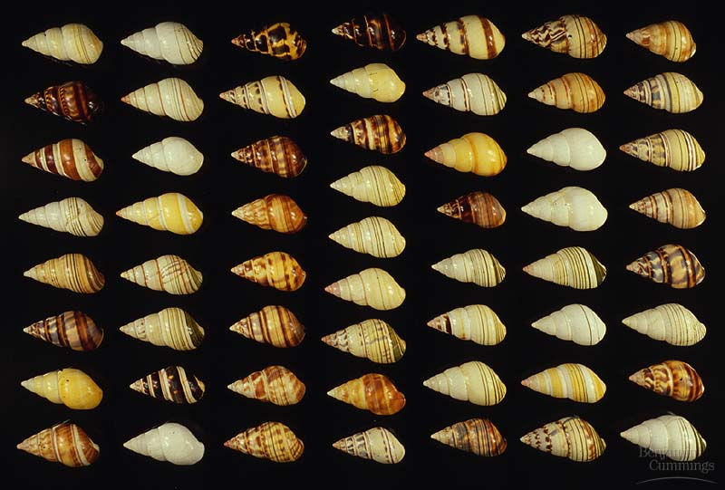
Population Genetics

Slide 2
What we know already
Sources of variation:
Mutation
Meiosis:
Independent assortment
Segregation
Crossing over
Sexual reproduction
Inheritance:
Monohybrid:
Complete dominance
Co-dominance
Incomplete dominance
Lethal alleles
Multiple alleles
Dihybrid inheritance
The effect of linked genes and crossing over on dihybrid
inheritance

Slide 3
Population Genetics
Factors affecting allele frequencies in a gene pool:
Migration
Genetic Drift
Natural Selection

Slide 4
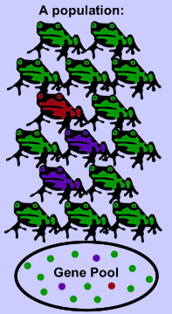
Population Genetics Terms
Species – similar organisms which interbreed & produce fertile offspring.
Population – all of the individuals of a species living in the same area.
Gene pool – all of the alleles of all the individuals in a population.
Allele frequency – the frequency of different alleles in a gene pool.

Slide 5
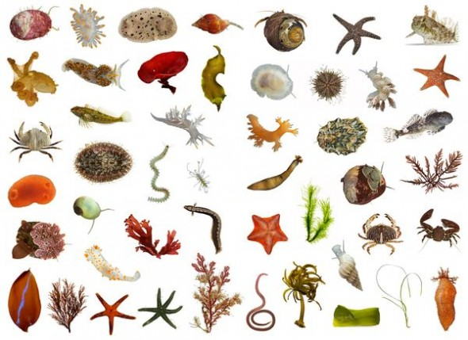
Species
How many different species?

Slide 6
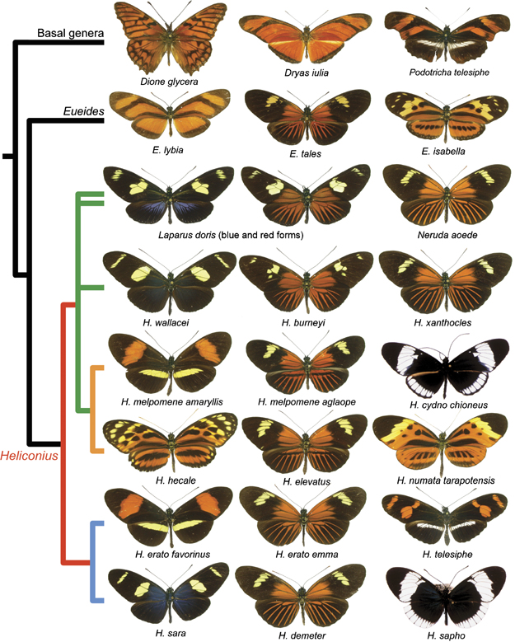
Species
How many different species?

Slide 7
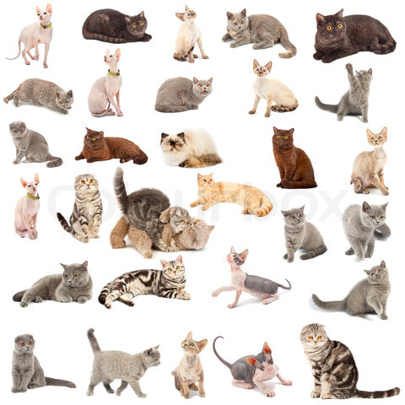
Species
How many different species?

Slide 8
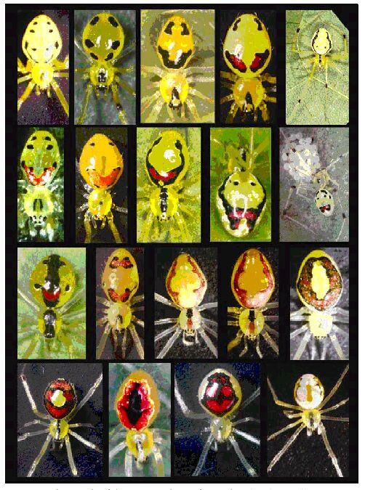
Species
How many different species?

Slide 9
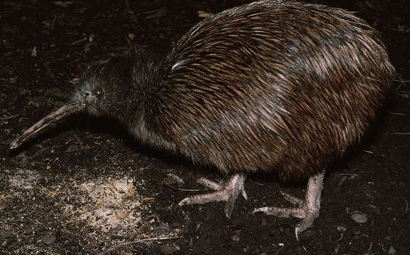
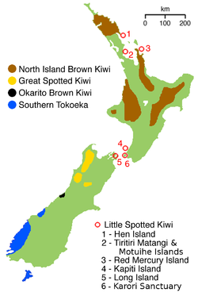
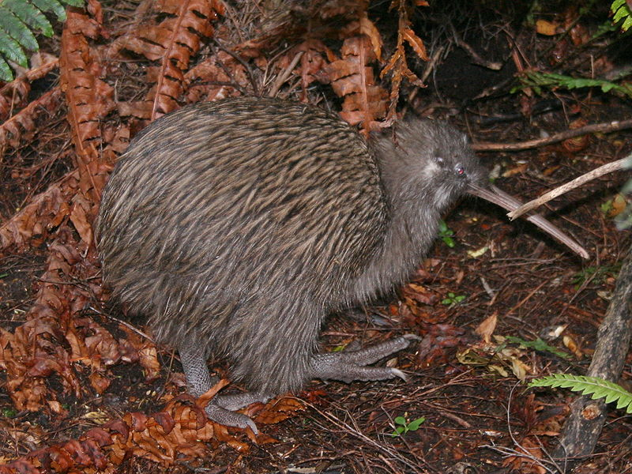
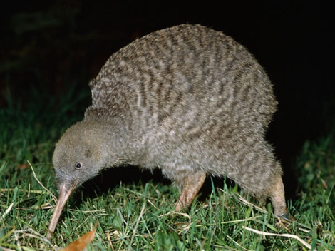
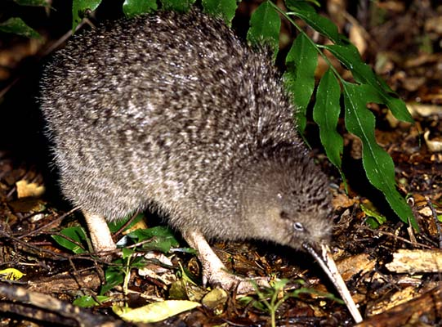
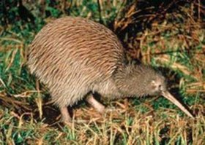
Populations
How many different populations for each species?
North Island Brown
Southern Tokoeka
Great Spotted
Okarito Brown
Little Spotted

Slide 10
Population Genetics Terms
What are the allele frequencies in this population?
Frequency (%) = occurrence x 100
total
Blue = BB
Green = Bb
Yellow = bb
Find the frequency (%) of each phenotype.
Calculate the frequency of each allele (B and b).
Blue = 5/10 = 50%
Green = 3/10 = 30%
Yellow = 2/10 = 20%
B = 50% + ½ 30% = 65%
b = 20% + ½ 30% = 35%

Slide 11
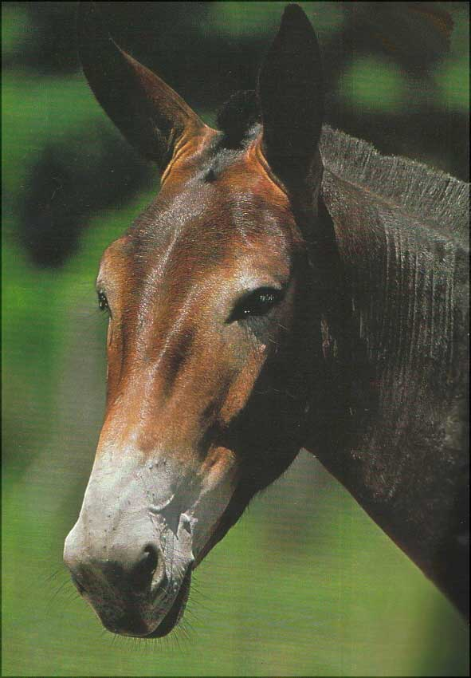
Population Genetics
Different species do NOT exchange genes by interbreeding.
Individuals created from crosses of different species are called hybrids.
Hybrids are often sterile or less viable e.g. Mule

Slide 12
Population Genetics
Factors affecting allele frequencies in a gene pool:
Migration
Genetic Drift
Natural Selection

Slide 13
Migration
Not every member of a species has to live in the same location.

Slide 14
Migration

Slide 15
Migration
Migration of individuals into or out of a population changes the allele frequencies.
5 red
5 blue
5 green
6 red
6 blue
3 green
2 red
4 blue
9 green
1 red
2 blue
12 green
4 red
9 blue
2 green

Slide 16
Migration
Migration of individuals into or out of a population changes the allele frequencies.
33% red
33% blue
33% green
40% red
40% blue
20% green
13% red
27% blue
60% green
7% red
13% blue
80% green
27% red
60% blue
13% green

Slide 17
Migration
Migration of individuals into or out of a population changes the allele frequencies.
1 red frog and 2 blue frogs move from the Lake population to the Volcano population
33% red
33% blue
33% green
40% red
40% blue
20% green
13% red
27% blue
60% green
39% red
44% blue
17% green
7% red
13% blue
80% green
27% red
60% blue
13% green
100% green

Slide 18
Migration
Key Points
Migration affects both the migrant’s original population AND its new population.
It changes the allele frequencies AND the number of individuals in each population.
It can cause the loss OR gain of genetic diversity in each population.

Slide 19
Migration
Migration is important to a species because it allows gene flow between populations.
Gene flow is movement of alleles between different populations of a species.
Gene flow allows the gene pool of a species to remain continuous. If there is no gene flow, over time the populations may speciate (become to separate species).

Slide 20
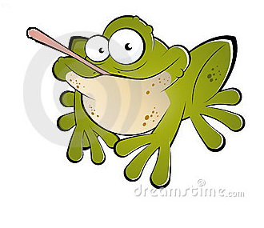
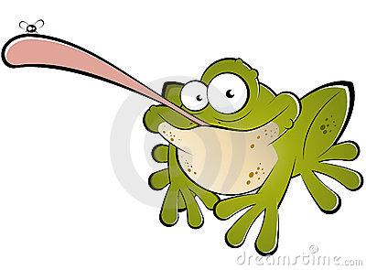
Why does gene flow matter?
Example
A mutation occurs in the Beach population giving the frogs a longer tongue which allows them to catch bigger, faster prey.
With gene flow, this beneficial mutation will gradually spread to all the populations.
Without gene flow, the Beach population would adapt to their different prey and could eventually end up becoming a different species from the other populations.
If the long- and short-tongued species ever had to compete for food, the short-tongued species would have to specialize in a different food source or it could die out.
Remember: MUTATION is the
ultimate source of all variation.

Slide 21
Migration
Immigration – moving into a population
Immigrant = In
Emigration – moving out of a population
Emigrant = Exit
Note: In this topic, when we talk about migration we mean individuals migrating between populations. Not the migration of a population as a whole, e.g. African herds, whales, geese.
Individual migration between populations changes allele frequencies.
All flying South for winter does not.

Slide 22
Population Genetics
Factors affecting allele frequencies in a gene pool:
Migration
Genetic Drift
Natural Selection

Slide 23
Genetic Drift
Sometimes changes in the allele frequency in a population is random.
As individuals die or are born, the allele frequencies of the population changes.

Slide 24
Genetic Drift
Simulation: M&M populations
Place one colour by each number.
Roll the dice five times to see which colours contribute to the next generation.
Repeat until one allele becomes “fixed” (is the only one left.
Calculate phenotype frequency in each generation.
Generation: 1 2 3
Rolls dice, gets 4, 3, 6, 5, 4, 5
(ignore 6s, roll again)
1.
2.
3.
4.
5.
Gen. | 1 | 2 | 3
Blue | 20% | 0% | 0%
Green | 20% | 0% | 0%
Red | 20% | 20% | 20%
Orange | 20% | 40% | 60%
Yellow | 20% | 40% | 20%
Rolls dice, gets 4, 1, 2, 6, 3, 1

Slide 25
Genetic Drift
The simulation shows that even though no colour of M&M is better than any other and the dice is random, changes can occur in the allele frequency of the population.
This change by random chance is called evolution by genetic drift.
Imagine repeating your experiment with 50 M&Ms of each colour – what would you expect?
http://www.biology.arizona.edu/evolution/act/drift/frame.html

Slide 26
Genetic Drift
Due to the Law of Large Numbers, small populations are much more susceptible to major changes from genetic drift than large populations.
There are two scenarios which cause small populations which can increase the chances of evolution by genetic drift:
Bottleneck Effect
Founder Effect

Slide 27
Genetic Drift
Bottleneck Effect
A bottleneck occurs when a catastrophic event suddenly reduces the population size
e.g. fire, flood, volcanic eruption, meteorite, human-related habitat destruction or predation.
The few remaining survivors are not likely to represent the allele frequencies of the original population.
Their genetic diversity is reduced

Slide 28
Genetic Drift
Bottleneck Effect
Several species of cheetah once roamed all of the Northern Hemisphere. Rapid climate change 10,000 years ago left only one species remaining with very little genetic diversity. Subsequent inbreeding has left cheetah susceptible to diseases, viruses and further climate change. Zoos aim to counter the effects of this bottleneck through breeding programs to maximise diversity.

Slide 29
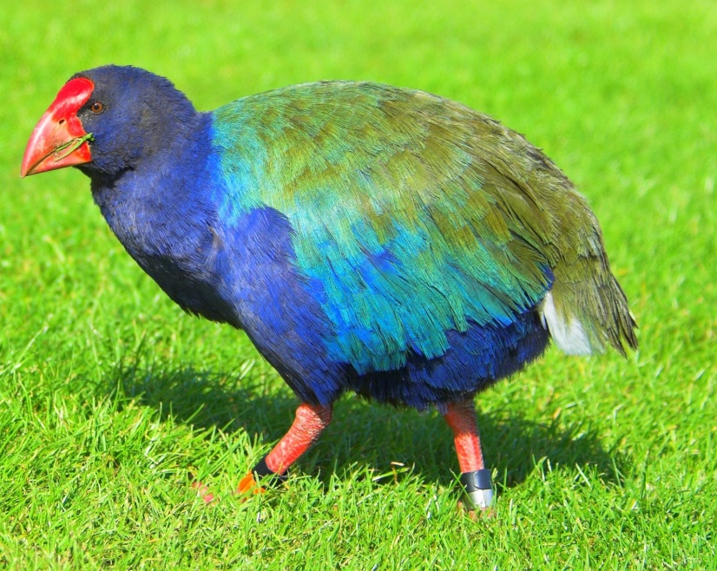
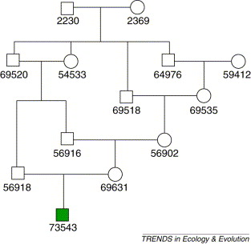
Genetic Drift
Bottleneck Effect
Takahe faced an even more dire problem. They were declared extinct in 1898 due to predation by introduced species (including humans). In 1948, a small population was located in Fiordland. The takahe population today is 216 and growing but inbreeding is still a major concern.

Slide 30
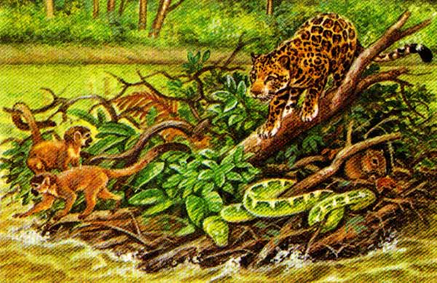
Genetic Drift
Founder Effect
The founder effect occurs when a small number of individuals colonize a new habitat where they are isolated from the original population e.g. an island.
This can occur by wind, currents, rafting, or human manipulation.

Slide 31
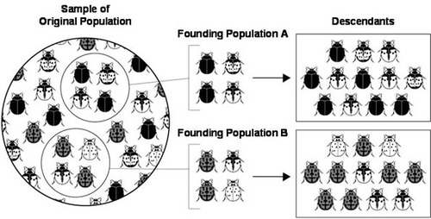
Genetic Drift
Founder Effect
The new small population has different allele frequencies than the original and lacks diversity.

Slide 32
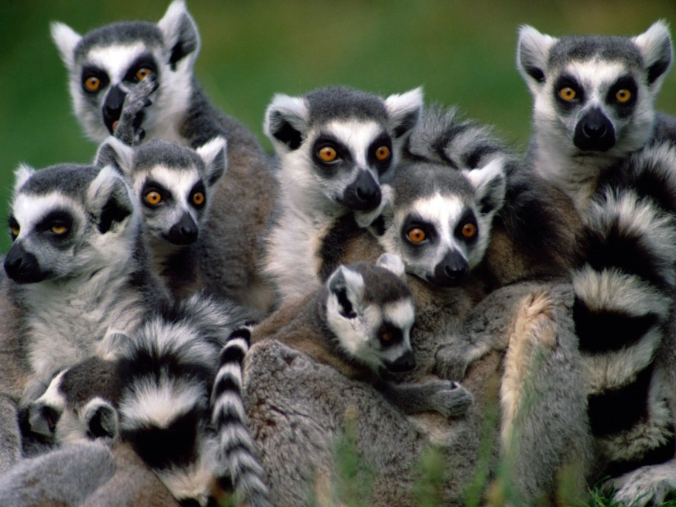
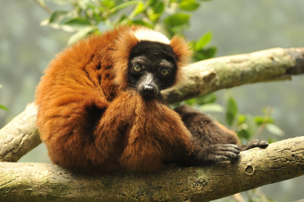
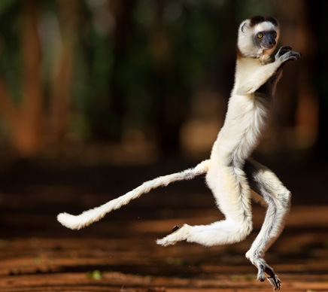
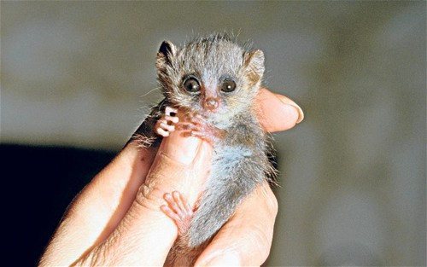
Genetic Drift
Founder Effect
Lemurs evolved from an ancient prosimian ancestor from Africa.
Lemurs rafted to Madagascar and evolved in isolation from their fellow primates e.g. monkeys, baboons, chimps, gorillas and humans.
The rich environment of Madagascar has allowed lemurs to diversify into 101 different species over the past 65 million years.

Slide 33
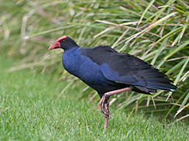
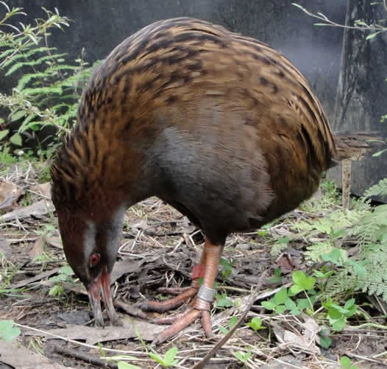
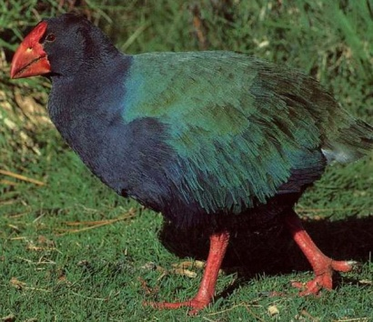
Genetic Drift
Founder Effect
Many of our unique species owe their distinction from other species to the Founder Effect.
Pukeko, Weka and Takahe are all from the Rail family. Weka and Takahe have lived in New Zealand for millions of years and show many unique characteristics compared to other Rails.
Pukeko reached New Zealand in the last 300 years so still closely resemble their Australian cousins, Purple Swamphens.
Flying Pukeko (left) and Purple Swamphen
found around Australasia (right).
Flightless Takahe (front).
Flightless weka (left) and flying Banded Rail found around Australasia (right)

Slide 34
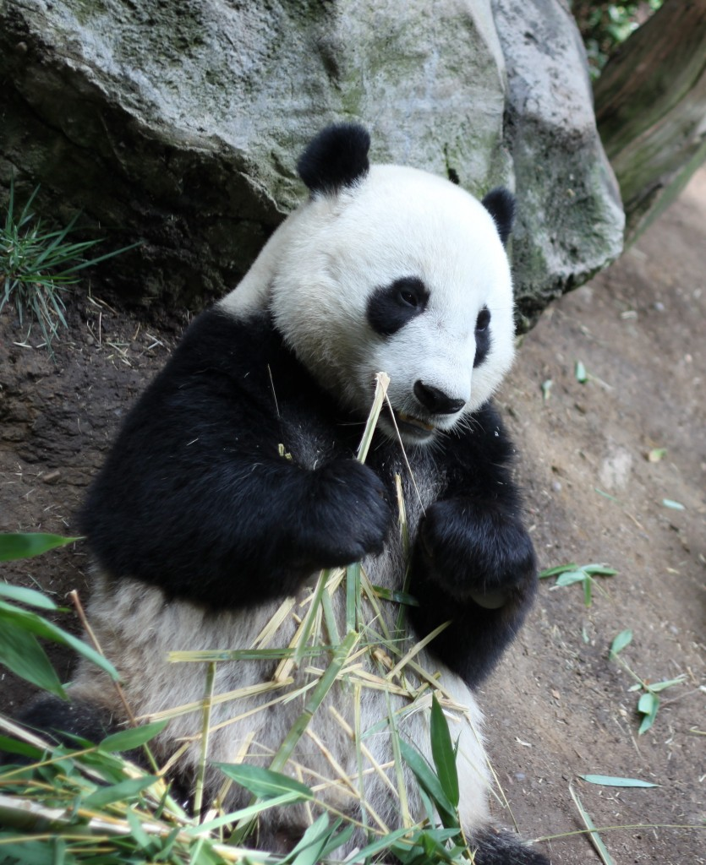
Genetic Drift
Founder Effect
Captive breeding programs in zoos and wildlife parks make increasing diversity an important focus.
Despite this, the genetic diversity of pandas in captivity was found to be much lower than wild populations.
This means they are more affected by evolution by genetic drift and at risk of inbreeding depression.

Slide 35
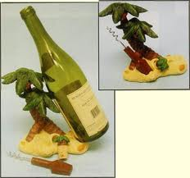
Genetic Drift
Summarise the examples of the Bottleneck Effect and the Founder Effect in the textbook on pages …

Slide 36
Genetic Drift Summary
Change in allele frequencies due to chance
More likely to affect small populations
Examples of small populations likely to be affected by genetic drift:
Bottleneck effect – disaster suddenly reduced population numbers
Founder effect – new colonists of an isolated area
In both cases:
allele frequency different from original population
range of alleles decreased
less genetic diversity
at risk of negative inbreeding effects e.g. disease susceptibility

Slide 37
Population Genetics
Factors affecting allele frequencies in a gene pool:
Migration
Genetic Drift
Natural Selection

Slide 38
Natural Selection
Migration and Genetic Drift cause changes in the allele frequencies of populations mostly due to chance.
However, it is not entirely chance that has shaped the characteristics of the species on Earth today.
Species adapt to their environment by natural selection.

Slide 39
Natural Selection
What is Natural Selection?
Video - http://www.youtube.com/watch?v=0SCjhI86grU

Slide 40
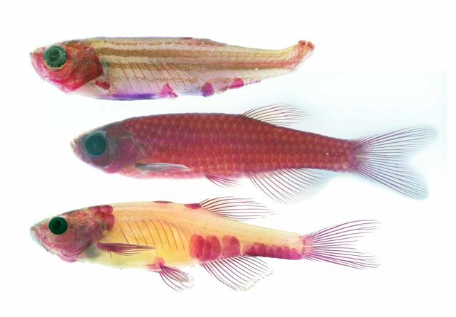
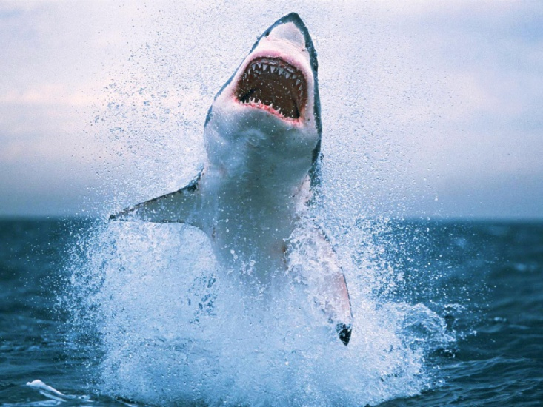
Natural Selection
There are two requirements for natural selection to occur:
Variation in a heritable trait
(offspring are slightly different from
their parents in some traits)
Differential survival
(that trait makes them more or less
likely to survive and reproduce)
Yummy pink one!

Slide 41
Natural Selection
Why does natural selection depend on heritable variation and differential survival?
If the variation which helps you to survive is not heritable, natural selection cannot occur.
Your Mum’s knowledge of bush tucker will not help you survive in the wilderness if she didn’t teach you. You are not genetically more capable of surviving.
If survival is random, then selection will not occur because survival is pure chance i.e. genetic drift.
A tornado killing all of your neighbours but not you is not due to your genetic superiority.

Slide 42
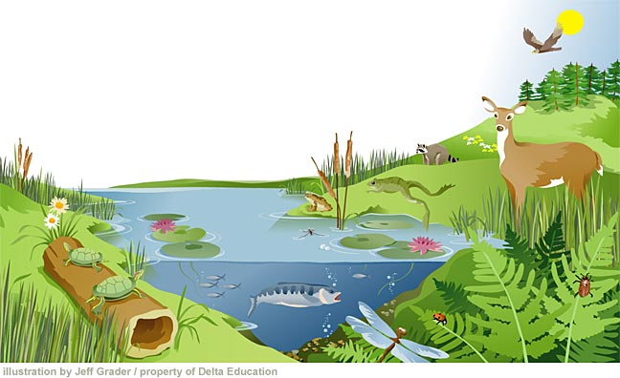
Natural Selection
The drivers of natural selection are called “selection pressures”. These can be:
Predators
Food availability
Light exposure
Temperature
Disease
Salinity
Parasites
Altitude
Chemicals
Anything that makes an animal more or less likely to survive and reproduce is a selection pressure.

Slide 43
Natural Selection
Fitness is the measure of natural selection success.
Fitness is how well an individual/species can survive and reproduce.
Individuals with high fitness will produce lots of offspring, passing on more of their genetic material than less fit individuals.

Slide 44
Natural Selection
Traits which increase fitness will accumulate in the gene pool over successive generations.
Example, green colour increases camouflage.
Working down the column, roll the dice for non-green colours – if even, they produce offspring, if odd they don’t.
Unlike the genetic drift scenario, one colour has greater fitness than the others.
Selection drives the allele frequency towards green.
Generation 1 2 3 4 5 6
Chance of producing next generation:
green = 100%
other = 50%
Also try: http://phet.colorado.edu/en/simulation/natural-selection

Slide 45
Types of Selection
Different selection pressures can result in different alleles being favourable or unfavourable (i.e. increasing or decreasing fitness).
In large populations, most variation can be measured as a bell-shaped curve, e.g. human height, weight etc.
Most individuals are in the middle of the range of trait, while very few are at the extremes.
If this were height, most people would be average height, while only a few are extremely short or extremely tall.
Frequency
(the proportion of individuals who show the trait)
Trait
(something physical, behavioural or physiological e.g. disease resistance)

Slide 46
Directional Selection
One end of the range has increased fitness.
e.g. Hares with longer legs are faster and better able to escape from foxes.
More likely to be
eaten by foxes
More likely to
escape
Frequency
Frequency
Hare Leg Length
Hare Leg Length
Hare population shows longer legs as a result of directional selection.

Slide 47
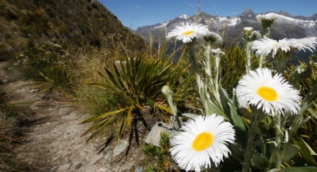
Directional Selection
One end of the range has increased fitness.
e.g. Shorter alpine daisies are less damaged by frost.
Less damage
More frost damage
Frequency
Frequency
Daisy Height
Daisy Height
Daisy population shows shorter stems as a result of directional selection.

Slide 48
Stabilising Selection
The middle of the range has increased fitness.
e.g. Birds who lay few eggs decrease their fitness, birds with too many may starve offspring.
Too many young to feed, will starve
Few offspring = low fitness
Frequency
Frequency
Number of Eggs Laid
Number of Eggs Laid
Brood size is optimized to increase mother’s fitness and offspring survival.

Slide 49
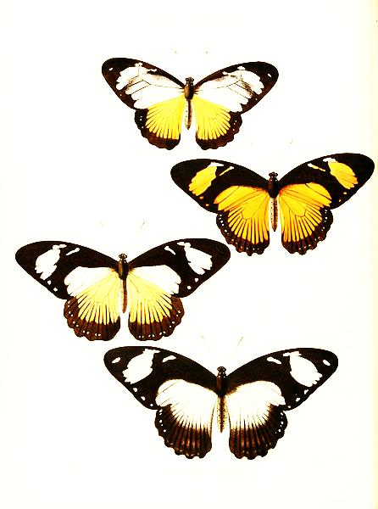
Diverging Selection
The extremes of the range have increased fitness.
e.g. Very pale and very bright African swallowtail butterflies look poisonous to birds and are avoided.
Look poisonous
Look poisonous
Frequency
Frequency
Wing Colour
Wing Colour
The extremes phenotypes are favoured. This could lead to two species evolving.

Slide 50
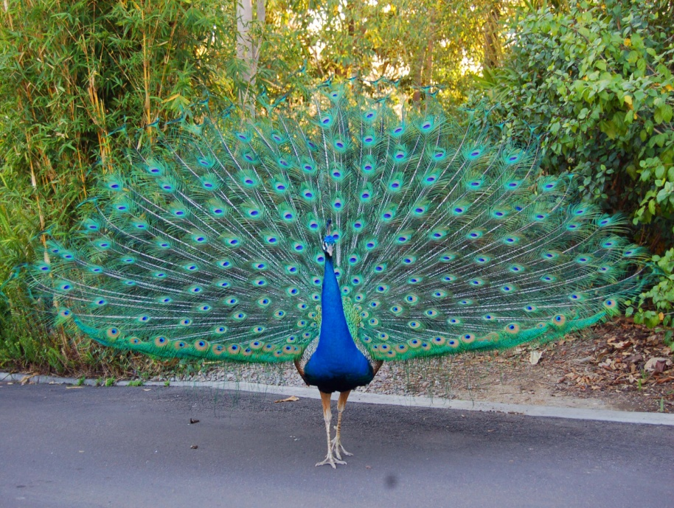
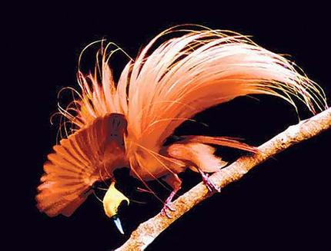
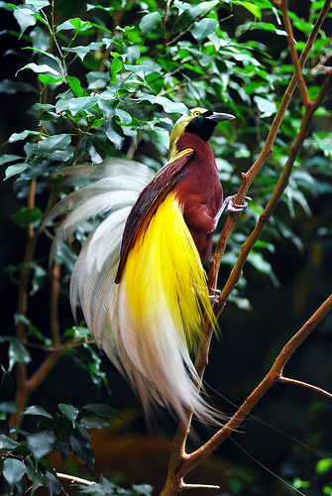
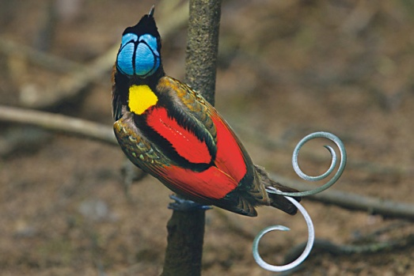
Sexual Selection
Non-random mating means that mate choice can also be a selection pressure. It can sometimes result in phenotypes that seem to defy the logic of natural selection.

Slide 51
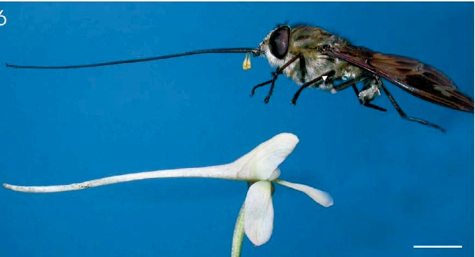
Coevolution
Coevolution occurs when there is a strong relationship between two species, either host-parasite, predator-prey or plant-pollinator.
Changes in one species drive changes in the other so they evolve together.

Slide 52
Summary of Natural Selection
Natural selection occurs if there is heritable variation in a population which causes differential survival and reproduction.
Due to different selection pressures, some individuals are more fit than others – they are more likely to pass on their successful “favoured genes”.
The successful genes accumulate in the population over time and the allele frequency of the gene pool changes – the population evolves.
Unsuccessful genes are eventually eliminated from the gene pool if they increase the chance of death or infertility.

Slide 53
Summary of Natural Selection
The effect of selection on the population as a whole depends on the type of selection pressure.
Selection can be directional (one extreme is favoured), stabilising (the middle is favoured) or diversifying (the extremes are favoured).
Sexual selection (non-random mating) and interspecies relationships (coevolution) can also be drivers of selection.

Slide 54
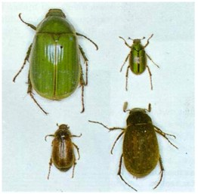
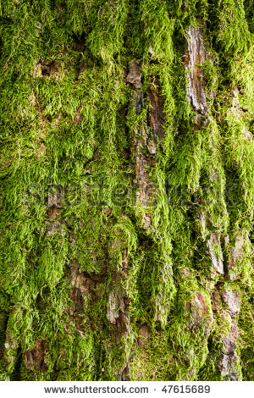
Describe what is happening in each scenario.
The allele frequency of green beetles has increased because they are better camouflaged in the new environment. This is directional selection.
1
2
3
Green tree moss is
introduced to the
area.
Years later…
25%
23%
37%
41%
26%
26%
12%
10%

Slide 55
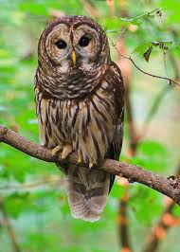
Describe what is happening in each scenario.
The allele frequency of small beetles has increased because they are less preferred by the new predator. This is directional selection.
1
2
3
A large insectivorous
owl moves into the
area.
Years later…
25%
23%
8%
43%
26%
26%
36%
13%

Slide 56
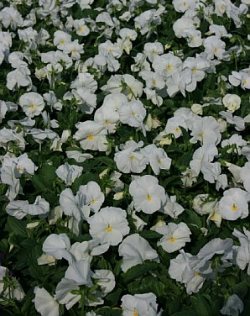
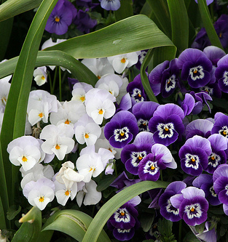
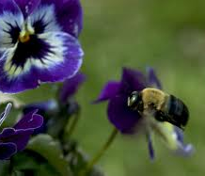
Describe what is happening in each scenario.
The allele frequency of pansies has changed due to the introduction of a new allele – purple. This genes was introduced by migration when pollen from a purple population was introduced by a pollen-carrying bee blown off course.
1
2
3
100% white pansies
A particularly strong
wind blows from an
unusual direction.
Years later…

Slide 57
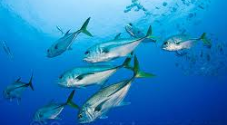
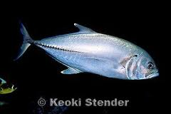
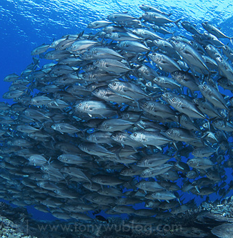
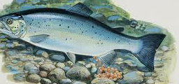
Describe what is happening in each scenario.
The allele frequency of male fish size has changed because extreme phenotypes are the most successful at reproducing. This is directional selection. This can only occur if male size is a heritable trait, not environmental.
1
2
3
Broad spectrum of sizes of
male fish.
Females prefer large
males.
Years later…
Small males are able
to sneak in to fertilize
female’s eggs.
Males either big or sneaky.

Slide 58
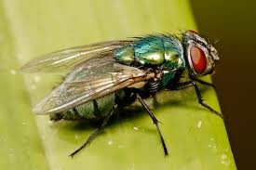
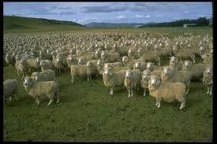
Describe what is happening in each scenario.
The allele frequency of the blowflies has changed due to a Founder Effect from a small sample of the original population’s alleles. Over time, natural selection has favoured alleles that make the new population too different to reproduce with the old – it’s a new species.
1
2
3
Years later…
The introduced blowfly
can no longer produce
fertile offspring when
crossed with Australian
blowflies.
The blowfly population
spreads across the
country.
Australian sheep blowfly
is introduced to NZ by
contaminated meat.

Slide 59
Describe what is happening in each scenario.
Extreme phenotypes in down:flight feather ratios decrease survival. Therefore the intermediate is favoured. This is stabilising selection.
2
Birds with more down
feathers have to expend
more energy in migration.
1
3
Years later…
All birds have a similar
ratio of down feathers to
flight feathers.
Birds with less down
feathers are at risk of
freezing in winter.
Birds have varying ratios
of down feathers
for insulation and flight
feathers for flying.

Slide 60
Describe what is happening in each scenario.
The allele frequency of the butterflies has changed due to a forest fire severely reducing the population size. This is a population bottleneck. The small population of survivors had different allele frequencies than the original population = genetic drift.
1
2
3
Years later…
30%
15%
A forest fire kills 95% of
the butterfly population
50%
20%
50%
5%
30%
0%

Slide 61
Unpacking an NCEA
Question

Slide 62
Step One: Read the info provided
all alleles in pop, random change, movement
diff. alleles passed on (ind. assort.,
segregation, mutations) migrants random
Both have random drift but small = v. sensitive to drift, less var., likely to fix. or lose
alleles; big = more Var. and large number = little overall change to gene pool
Really means give similarities and differences!
Step Two: Use this outline as a plan!
Step Three: Look for key vocab!
Step Four: Put key words in your plan
Step Five: Write answer using linking words
Step Six: Check your answer links back to the info at the start!

Slide 63
Part one of E7 answer – got genetic drift wrong but still got excellence!
Good start due to clear definitions and use of a linking phrase.
Genetic drift = change in relative frequency in which an allele occurs in
a population due to random sampling and chance.

Slide 64
Part two of E7 answer – giving example scenarios
Contrasting effect on small and large population = link back to start info

