Slide 1
Deer
By Paige and Christine

Slide 2
Land and Climate conditions
Deer is best farmed on hill country
a temperate climate allowing year-round grazing of pasture, with some additional feed in winter, which was a management system that deer could adapt to.
They can adapt to most sorts of weather, with deer they are farmed on the hill country so they are going to have all the weather conditions.

Slide 3
Environmental Impact
Unlike most traditional livestock, deer have an extremely seasonal feed intake-high in spring and summer, less in winter.
This is a reaction to day length
Deer from temperate or cold environments have developed this characteristic for survival reasons over thousands of years
Feeding standards which recognise the seasonal aspects of feed intake have been developed, and those are different for the each sex

Slide 4
Technology
there has been increasing interest in the application of reproductive technology to the conservation and management of natural populations of deer. genetics specialist LIC launched Deer Improvement nearly four years ago to apply its experience in genetic improvement and reproductive technologies to a different species where there was clear potential to add value. A breeding programme targeting venison growth rate was the initial focus because venison is not only the largest contributor to deer farmers’ income, but genetic progress had previously been slow. This was due to two factors, the industry had not fully utilised modern genetic evaluation tools, and reliance on natural mating severely limited the diffusion of elite genes into commercial herds.
Given between commercial and industry-good imperatives, the decision was not a hard one. Deer Improvement has begun to invest in velvet/trophy genetics and is offering them in the form of an AI service to commercial farmers.

Slide 5
Qualifications
Telford offers a certificate in deer management at level 4
To be able to enrol in this course, you must have completed the Telford Certificate in Deer Knowledge (level 3 or equivalent)

Slide 6
Economy-Venison
From 2005-2010 the money made off venison decreased
This started at $40,523 in 2005 and went to $21,339.28 in 2010
It then rose to $22,920 in 2010/2011

Slide 7
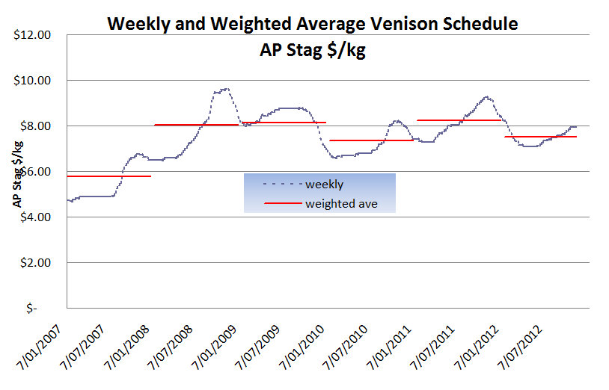
Venison

Slide 8
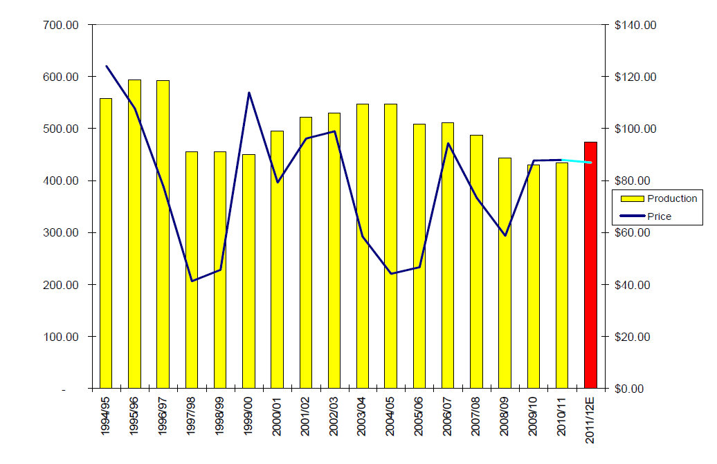
Economy-Velvet Production levels

Slide 9
New Zealand Society
Deer farming is often forgotten about in New Zealand as New Zealand is thought of as a sheep and beef farming country.
When deer first arrived in New Zealand, 150 years ago, they were considered a ‘pest’ because there were no predators.
With deer numbers increasing rapidly it was having a huge impact on the environment, especially the native forestry.
When culling first began for deer, it took off slowly but then peaked with 100-200 deer carcasses being dragged from the forests each day.

Slide 10
Political
Key reasons for the large price decrease are the impact of the exchange rate.
The weighted average velvet price for the 2003/04 season sat at around $60/kg compared with $100/kg last season.
The schedule drop saw the net trading profit on the North Island model decline from a peak of $98,400 in 2001/02 to a loss of almost $7,000 in 2003/04. Next year's outlook looks marginally better, with a net trading profit anticipated of $23,255.

