Slide 1
Land Use in New Zealand
An introduction to how we use our land.

Slide 2
How do we use the land?
Primary
Production

Slide 3
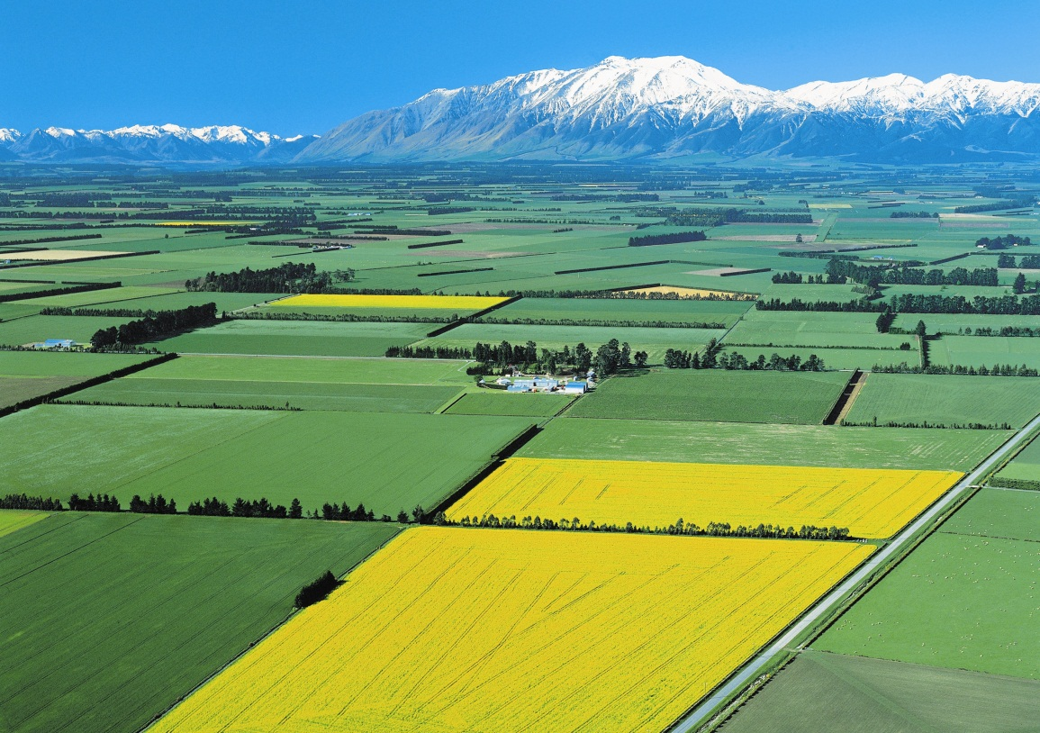
Land Types
Flat plains
Growing crops
Feeding young
stock
Dairying
Most flat land in New Zealand is in the South Island, especially the Canterbury and Southland plains and Central Otago.

Slide 4
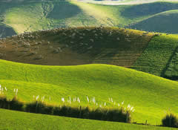
Land Types
Rolling Hill Country
Sheep, beef &
deer farming
Forestry
Most forestry is in the North Island. Hill country is farmed across the entire country, with the exception of the West Coast of the South Island.

Slide 5
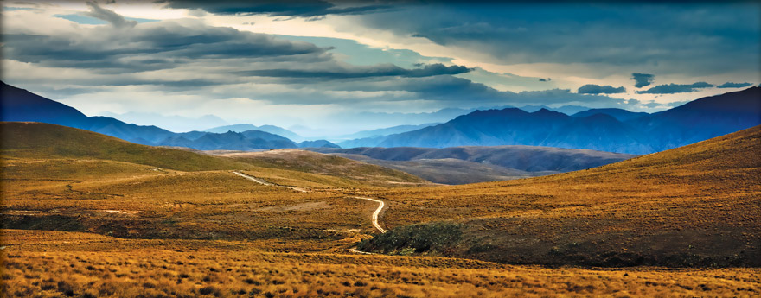
Land Types
High Country
Merino
Tussock grasslands extend from Marlborough to Southland. They lie in the “rain shadow” between the alps and the plains.

Slide 6
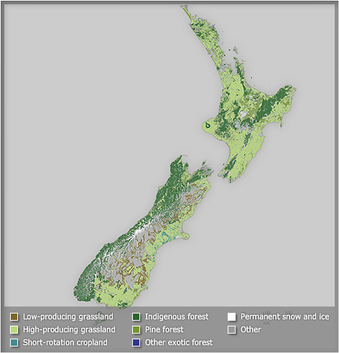
Land Types
http://www.teara.govt.nz/en/interactive/17077/new-zealand-vegetation-cover

Slide 7
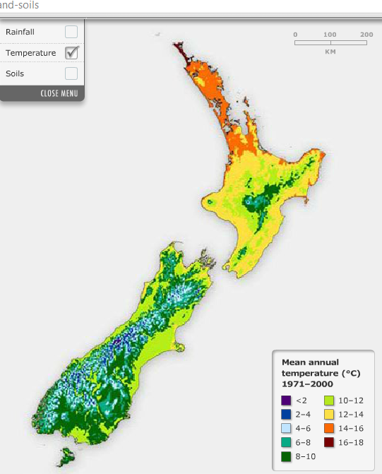
Climate
Temperature decreases from north to south.
Auckland average = 15.3°C
Dunedin average = 10.8°C
Temperature also decreases by about 0.5°C with every 100m increase in altitude.

Slide 8
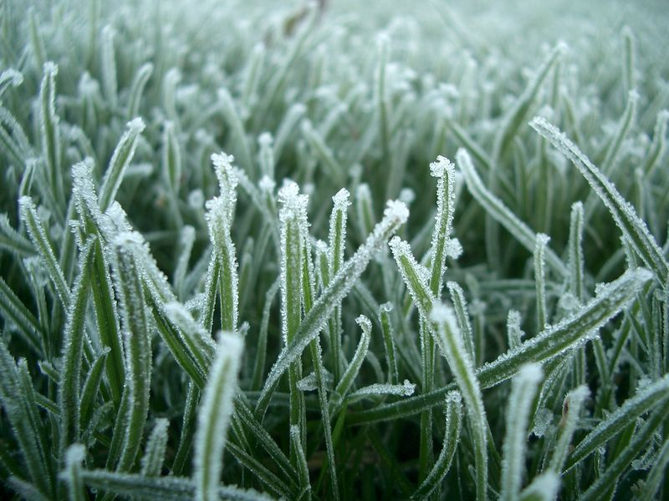
Climate
Minimum winter temperatures affect the flowering and seeding patterns of some plants. If the temperature is less than 5°C, plant growth will stop. However, it is the number of frost-free days in a year that dictates where frost-sensitive plants can be grown.

Slide 9
Ground Frost Days
Average number of ground frost days per year in North and South Island
locations between 1981 and 2010
LOCATION | FROST DAYS
Kaitaia | 0.4
Whangarei | 11.3
Auckland | 8.9
Tauranga | 45.1
Hamilton | 52.8
Rotorua | 45.7
Gisborne | 29.8
Taupo | 82.1
New Plymouth | 13.5
Napier | 23.6
Wanganui | 7.0
Palmerston North | 41.4
Masterton | 62.4
Wellington | 9.9
LOCATION | FROST DAYS
Nelson | 86.2
Blenheim | 51.9
Westport | 19.7
Kaikoura | 16.3
Hokitika | 47.7
Christchurch | 80.4
Mt Cook | 122.8
Lake Tekapo | 157.8
Timaru | 93.0
Milford Sound | 58.3
Queenstown | 118.8
Alexandra | 121.8
Dunedin | 50.5
Invercargill | 94.8

Slide 10
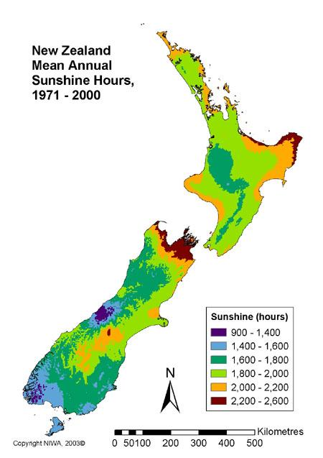
Climate
If a sun-loving plant doesn't receive enough sun, it may produce less foliage and flowering. If a shade-loving plant receives too much sun, the foliage may wilt and scorch. Either way, a plant is put under a lot of stress when trying to grow in improper lighting conditions.

Slide 11
Climate
Rainfall varies markedly across New Zealand – from more than 5,000 millimetres annually in Fiordland to less than 400 millimetres in Central Otago.
Plant growth depends on available moisture in the soil, which is the difference between rainfall and evaporation in a given period.
Moisture deficits occur when more water evaporates from the soil than is replaced by rain, usually in late spring and early autumn.

Slide 12
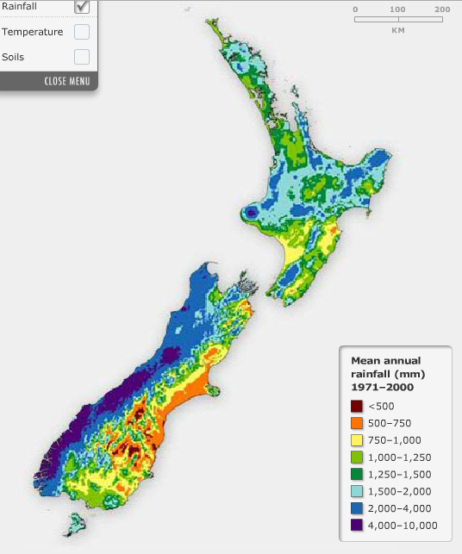
Climate
Droughts are common on the east coasts of New Zealand, but not on the west. In all regions, the soil on steep slopes, especially north-facing aspects, is drier than soil on nearby flat land.

Slide 13
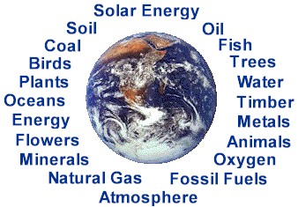
What is primary production?
The primary sector of the economy is the sector of an economy making direct use of natural resources.
This includes agriculture, forestry and fishing, mining, and extraction of oil and gas.

Slide 14
New Zealand’s Primary Industry

Slide 15
New Zealand’s Primary Industry

Slide 16
New Zealand’s Primary Industry

Slide 17
New Zealand’s Primary Industry

