Slide 1
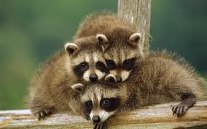
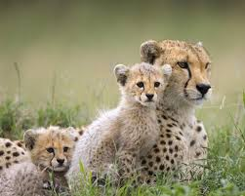
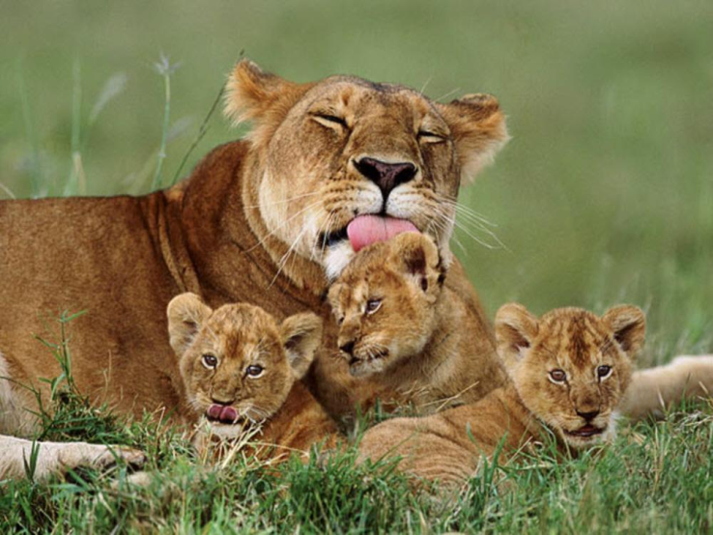
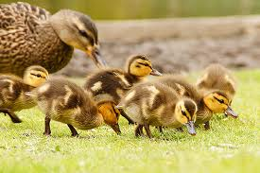
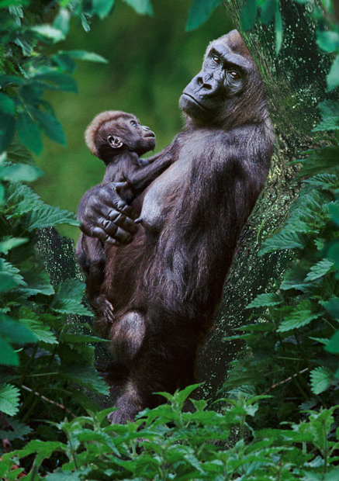
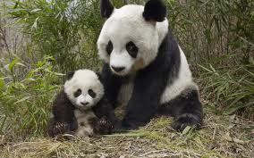
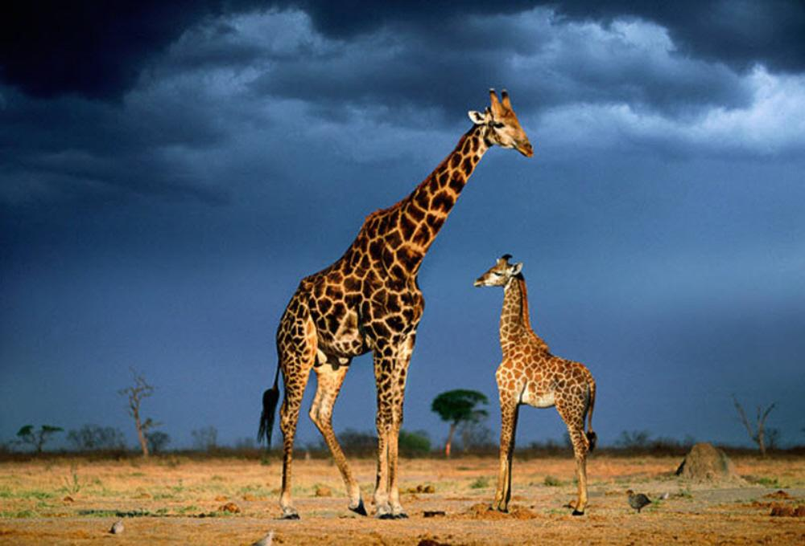
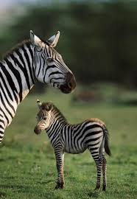
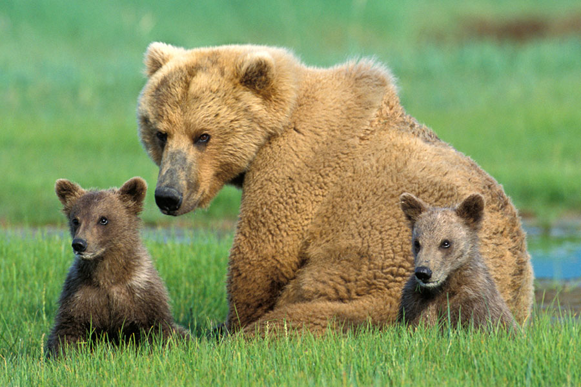
Inheritance
The acquisition of traits genetically transmitted from parents to offspring

Slide 2
Inheritance
The next section of this unit involves understanding the different ways in which genes are passed from parents to offspring and how the genotype is expressed in the phenotype.
It is very important to remember that fertilisation is random, so when we predict offspring ratios, we are talking about likelihoods, not actual individuals.

Slide 3
Types of Inheritance
Monohybrid Inheritance:
Complete dominance
Co-dominance
Incomplete dominance
Lethal alleles
Multiple alleles
Dihybrid Inheritance

Slide 4
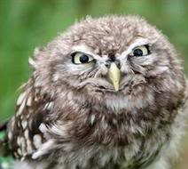
Important Vocab
Monohybrid – the cross between parents at a single gene locus.
Gene
Allele
Genotype
Phenotype
Dominant allele
Recessive allele
Homozygous
Heterozygous
Judgy Owl wants you to know these definitions by heart.

Slide 5
Mendelian Genetics
The types of inheritance we are looking at are often referred to as Mendelian inheritance, after Gregor Mendel.
They refer to discontinuous variation, where single genes produce phenotypes which have discrete classes e.g. red vs. white.
In contrast, continuous variation is the result of many genes working together and produces a spectrum of phenotypes e.g. skin colour

Slide 6
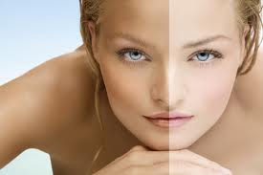
Continuous or discontinuous?
Skin colour
Earlobe attachment
Sex
Height
Hairiness
Tongue rolling
Hitchhikers thumb
Nose width
Tooth gap
Hair colour
Puberty age
Shoe size
The interaction between genes and the environment is
much more obvious in continuous traits.

Slide 7
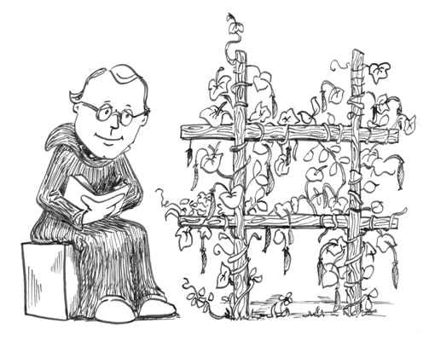
Mendelian Genetics
Gregor Mendel was an Austrian monk who first developed the theory of genetic inheritance from his observations of complete dominance in pea plants.
http://www.youtube.com/watch?v=GTiOETaZg4w

Slide 8
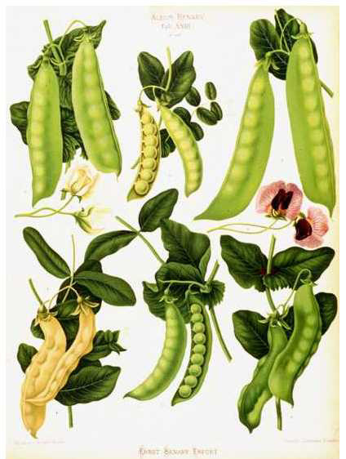
Mendelian Genetics
Pea plants show complete dominance in the following traits:
Purple vs. white flowers
Axial vs. terminal flowers
Long vs. short stems
Round vs. wrinkled seeds
Yellow vs. green seeds
Inflated vs. constricted pods
Yellow vs. green pods

Slide 9
Types of Inheritance
Monohybrid Inheritance:
Complete dominance
Co-dominance
Incomplete dominance
Lethal alleles
Multiple alleles
Dihybrid Inheritance

Slide 10
Complete Dominance
One allele is completely dominant over the other.
Heterozygous individuals are called “carriers” because they carry a hidden allele that they do not express but may pass on to offspring.

Slide 11
Complete Dominance
We can predict offspring genotype and phenotype ratios using Punnett Squares.
Again, the ratios we get from our Punnett squares are a probability estimate NOT the actual exact number and order of offspring produced by every mating.

Slide 12
Complete Dominance
How to do a Punnett Square.
1) Choose a letter to represent the gene (something where big and little letters look quite different works best, e.g. Gg or Dd not Cc)
2) Write down which trait is expressed by the dominant and by the recessive allele beside their big or little letter. Dominant allele is big, recessive is little.

Slide 13
Complete Dominance
3) Decide what the genotype of each parent is and write it down.
4) Draw their gametes underneath this.
5) Put the gametes (one letter per box) around the outside of your Punnett Square.
6) Fill in the boxes.
7) Calculate the offspring genotype ratio.
8) Calculate the offspring phenotype ratio.

Slide 14
Complete Dominance
In rabbits, black fur is dominant over white fur. Show the cross of a heterozygous black male with a homozygous white female.
Key:
Parents & gametes:
Offspring genotype ratio:
Offspring phenotype ratio:
B – black, b - white
B b
b
b
Bb bb
Bb bb
Bb x bb
B b b b
1 Bb : 1 bb
1 Black : 1 White

Slide 15
Complete Dominance
In some cases, it is important to know the genotype of an animal.
Pure-breeding animals are homozygous for a trait.
e.g. A cow could be pure-breeding for the recessive trait of horns.
Genotype = hh
How could you tell what the genotype of a hornless bull was?

Slide 16
Complete Dominance
A test cross is when you breed an animal showing a dominant phenotype (with an unknown genotype) with a recessive individual.
If offspring with a recessive phenotype are produced, the individual must be heterozygous.
If no recessive offspring are produced in several matings, the individual can be assumed to be homozygous dominant and included in breeding programs as a pure-breeding individual.

Slide 17
Complete Dominance
Test cross
Key
Parents and gametes
Offspring genotype ratio:
Offspring phenotype ratio:
Test cross shows that the male is heterozygous.
H – hornless, h - horns
H h
h
h
Hh hh
Hh hh
H? x hh
H ? h h
1 Hh : 1 hh
1 Hornless: 1 Horned

Slide 18
Complete Dominance
Test cross shows that the male is homozygous.
He can be used in the breeding program because he is pure breeding.
Test cross
Key
Parents and gametes
Offspring genotype ratio:
Offspring phenotype ratio:
H – hornless, h - horns
H H
h
h
Hh Hh
Hh Hh
H? x hh
H ? h h
All Hh
All hornless

Slide 19
Types of Inheritance
Monohybrid Inheritance:
Complete dominance
Co-dominance
Incomplete dominance
Lethal alleles
Multiple alleles
Dihybrid Inheritance

Slide 20
Co-dominance
Some traits show a type of inheritance called co-dominance.
Co-dominance means both alleles are equally dominant so BOTH are shown in heterozygous individuals.
Two different capital letters are used to symbolise equally dominant alleles.
Three different phenotypes can be produced.

Slide 21
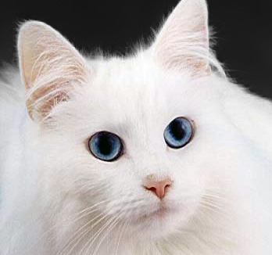
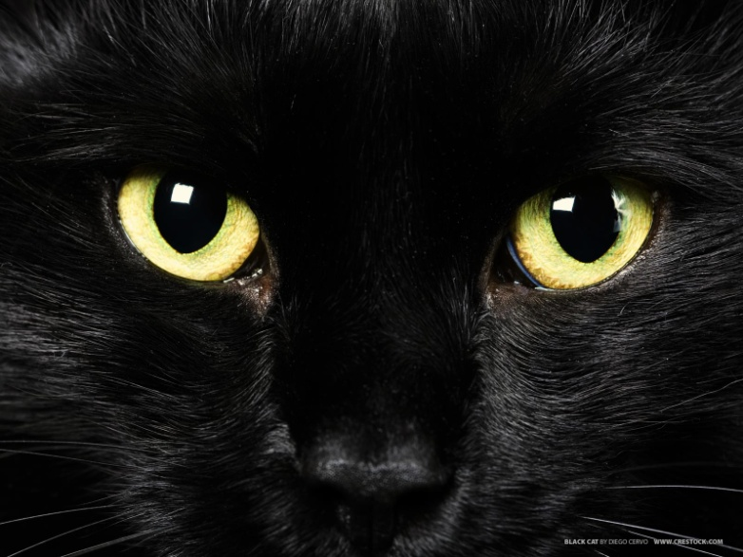
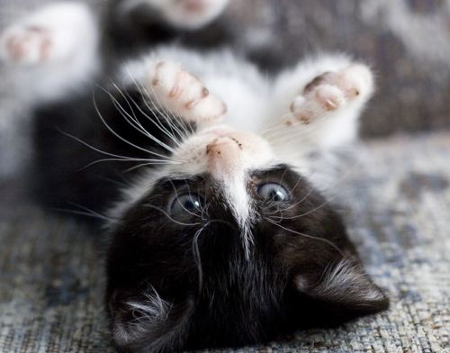
Co-dominance
Both alleles are shown in the phenotype of heterozygotes.
WB
WW
BB

Slide 22
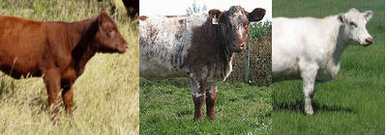
Co-dominance
Both alleles are shown in the phenotype of heterozygotes.
RR
RW
WW
“Roan”

Slide 23
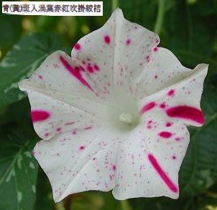
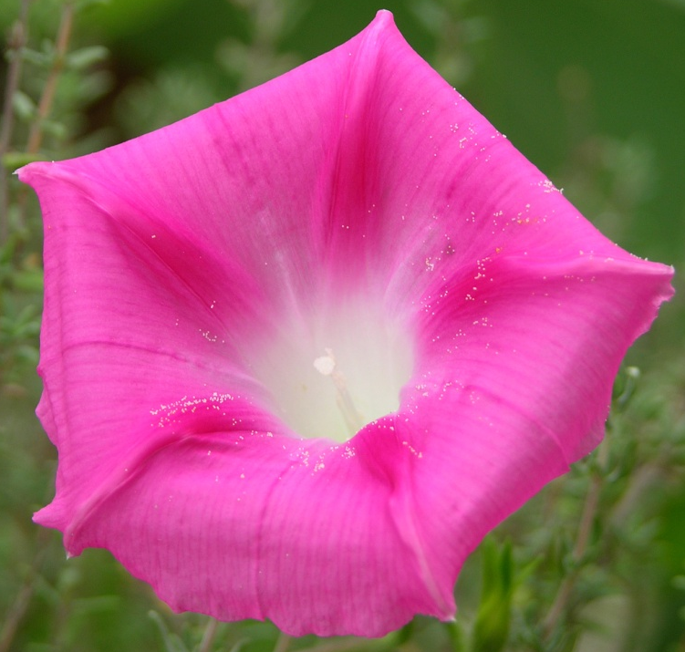
Co-dominance
Both alleles are shown in the phenotype of heterozygotes.
WW
RW
RR

Slide 24
Co-dominance
How do you spot an example of co-dominance?
Three alleles are produced
The heterozygote condition is to show both alleles equally e.g. the coat contains red hairs AND white hairs.

Slide 25
Types of Inheritance
Monohybrid Inheritance:
Complete dominance
Co-dominance
Incomplete dominance
Lethal alleles
Multiple alleles
Dihybrid Inheritance

Slide 26
Incomplete Dominance
This is like co-dominance, in that three alleles are produced.
BUT instead of the heterozygote showing both alleles equally, the heterozygote phenotype is a blend of both alleles.
We use the complete dominance system of two letters to show incomplete dominance even though one isn’t dominant over the other.

Slide 27
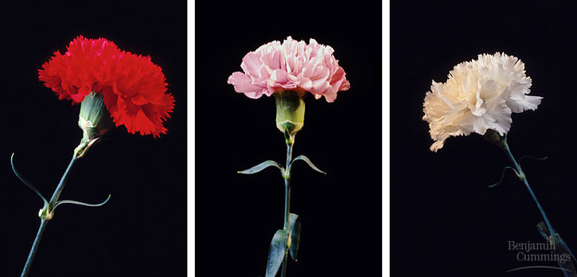
Incomplete Dominance
The heterozygote phenotype is an intermediate blend of the other two.
RR
Rr
rr

Slide 28
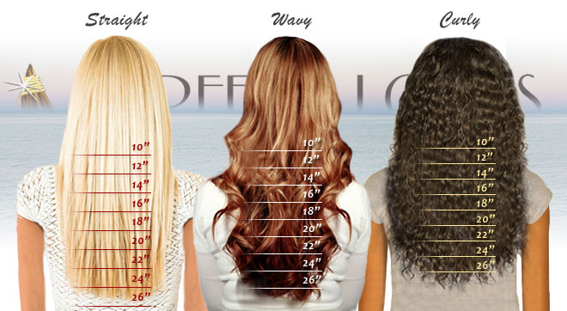
Incomplete Dominance
The heterozygote phenotype is an intermediate blend of the others.
cc
Cc
CC

Slide 29
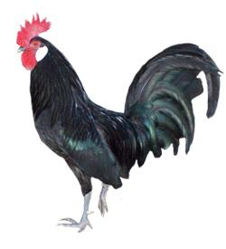
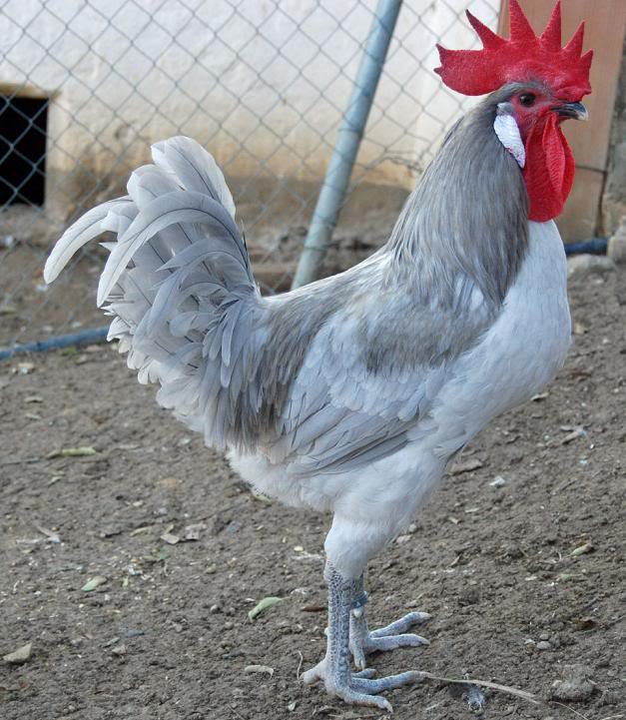
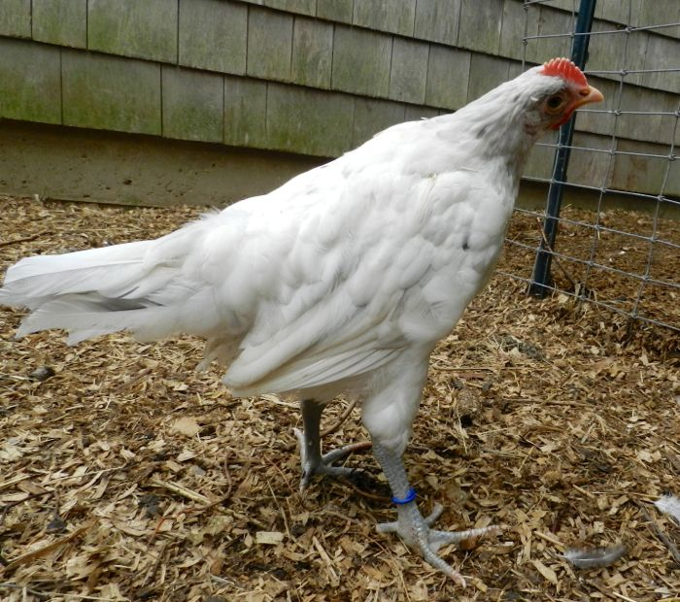
Incomplete Dominance
The heterozygote phenotype is an intermediate blend of the others.
BB
Bb
bb

Slide 30
Incomplete vs. Co-dominance
Be VERY careful when reading the description of phenotypes.
If it says the animals look an intermediate colour, is it
Because it makes equal numbers of each hair/feather colour?
Because all the hairs/feathers are an intermediate colour?
Which is which?
Co-dominance
Incomplete dominance

Slide 31
Types of Inheritance
Monohybrid Inheritance:
Complete dominance
Co-dominance
Incomplete dominance
Lethal alleles
Multiple alleles
Dihybrid Inheritance

Slide 32
Lethal Alleles
Lethal alleles occur when a mutation results in an allele that produces a non-functional version of an essential protein.
If an individual inherits a lethal combination of mutated alleles, it will die before or shortly after birth.
This will alter the expected offspring ratios.

Slide 33
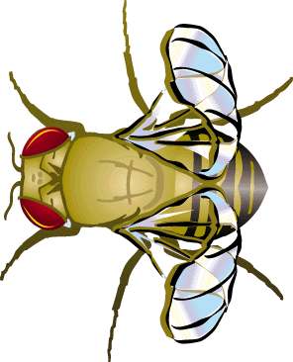
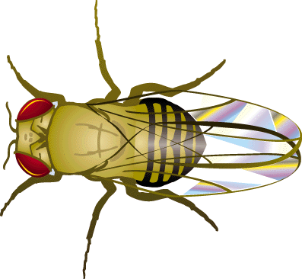
Lethal Alleles
In fruit flies, a mutated dominant allele produces curly wings (C) instead of normal (c).
Homozygous dominant (CC) flies do not survive.
CC
Cc
cc

Slide 34
Lethal Alleles
With a heterozygous cross, we expect a 3:1 phenotype ratio.
BUT, because the homozygous dominant individuals die, the ratio becomes
2 curly:1 normal
C c
X
C
c
CC Cc
Cc cc

Slide 35
Types of Inheritance
Monohybrid Inheritance:
Complete dominance
Co-dominance
Incomplete dominance
Lethal alleles
Multiple alleles
Dihybrid Inheritance

Slide 36
Multiple Alleles
Multiple allele inheritance occurs when a gene has more than two alleles.
Each individual still only has two copies of the gene.
The most well-known example of multiple alleles is human blood groups, which show BOTH co-dominance AND complete dominance.

Slide 37
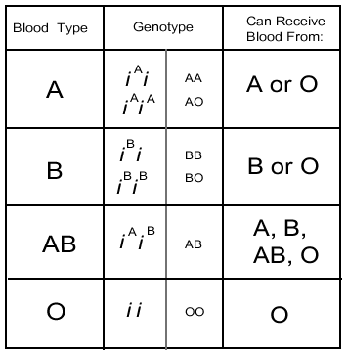
Multiple Alleles
I^{A} and I^{B} can be co-dominant, giving blood type AB.
I^{A} and I^{B} are completely dominant to i, producing type A (I^{A}i) and type B (I^{B}i).
ii is the homozygous recessive type O.
I
I
I
I
I
I
I
I

Slide 38
Multiple Alleles
Antibodies identify foreign objects and attack them.
Type AB has no antibodies, so can accept blood from anyone.
Type O has both anti-A and anti-B antibodies so can only get blood from type O.
Type A has anti-B and Type B has anti-A antibodies.
I
I
I
I
I
I
I
I

Slide 39
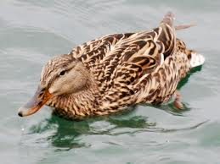
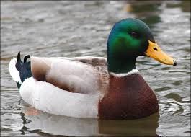
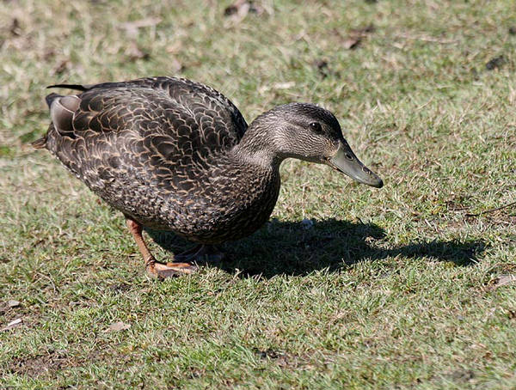
Exam Question
An example of multiple alleles is one that determines the feather pattern of mallard ducks. One allele M, produces the wild-type mallard pattern. A second allele M^{R}, produces a different pattern called restricted, and a third allele, m^{d}, produces a pattern termed dusky.
In this series, restricted is dominant over mallard and dusky, and mallard is dominant over dusky:
M^{R} > M > m^{d}

Slide 40
Exam Question
There are six genotypes possible with these three alleles to produce the three phenotypes.
Discuss why there is only one combination of parental genotypes which can produce offspring that show all three phenotypes in the F1 offspring.
In your answer you should complete the Punnett square to show the cross, and clearly identify the genotype and phenotype proportions expressed as a percentage or ratio. Refer to your completed Punnett square in your discussion.

Slide 41
Exam Question
M^{R} m^{d}
M
m^{d}
M^{R}M Mm^{d}
M^{R}m^{d} m^{d}m^{d}
Parents: M^{R}m^{d} x Mm^{d}
Genotype ratio: 1M^{R}M: 1Mm^{d}: 1M^{R}m^{d} : 1m^{d}m^{d}
Phenotype ratio: 2 restricted : 1 mallard : 1 dusky
Only this cross will produce all three phenotypes because in order for the homozygous recessive dusky phenotype to be expressed, both parents must carry a recessive allele.
If they both have a recessive allele, then to produce the mallard and restricted phenotypes, one parent must carry the dominant MR allele to produce restricted offspring and the other must carry the dominant M allele to produce mallard offspring.
As indicated by the Punnett square, this should result in an offspring ratio of 2 restricted: 1 mallard : 1 dusky offspring.

Slide 42
Types of Inheritance
Monohybrid Inheritance:
Complete dominance
Co-dominance
Incomplete dominance
Lethal alleles
Multiple alleles
Dihybrid Inheritance

Slide 43
Dihybrid Inheritance
So far we have been looking at monohybrid inheritance: the inheritance patterns of ONE gene.
With dihybrid inheritance, we look at TWO traits controlled by TWO genes and see how they are inherited together.
They may be on the same chromosome (LINKED GENES) or not (unlinked genes).

Slide 44
Dihybrid Inheritance
Because we are looking at two genes, we now have two letters in each gamete and four letters to represent offspring.
For example, pea gametes will have a gene for height AND a gene for seed colour.
Pea offspring will have two copies of each gene, one from each parent.
T = tall, t = short
Y = yellow seed, y = green seed

Slide 45
Dihybrid Inheritance
If we have parents (the P generation) which are pure-breeding tall & yellow (TTYY) and pure-breeding short and green (ttyy), their offspring (the F1 generation) look like this:
TTYY x ttyy
F1 (first filial) generation
TY
TY ty
ty
TtYy
All F1 offspring are TtYy
Tall and yellow seed
Note: Pollen don’t have tails but it helps to see them anyway.

Slide 46
Dihybrid Inheritance
Crossing these offspring produces an F2 generation. Because they are all heterozygous, there are four possible gamete produced by each offspring.
TtYy TtYy
F2 (second filial) generation
TY
TY
 | TY | Ty | tY | ty
TY | TTYY | TTYy | TtYY | TtYy
Ty | TTYy | TTyy | TtYy | Ttyy
tY | TtYY | TtYy | ttYY | ttYy
ty | TtYy | Ttyy | ttYy | ttyy
Ty
Ty
tY
tY
ty
ty

Slide 47
Dihybrid Inheritance
A dihybrid heterozygous cross results in a 9:3:3:1 phenotype ratio.
9 Tall & Yellow
3 Tall & Green
3 Short & Yellow
1 Short & Green
 | TY | Ty | tY | ty
TY | TTYY | TTYy | TtYY | TtYy
Ty | TTYy | TTyy | TtYy | Ttyy
tY | TtYY | TtYy | ttYY | ttYy
ty | TtYy | Ttyy | ttYy | ttyy

Slide 48
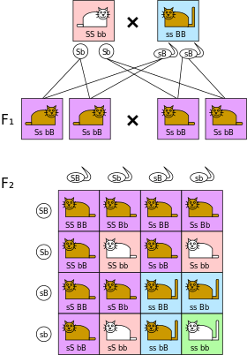
Dihybrid Cross
TWO traits
Tail length:
S – short tail
s – long tail
Coat colour
B – brown coat
b – white coat
Again, 9:3:3:1 is the offspring phenotype ratio
from a dihybrid heterozygous cross.

Slide 49
Dihybrid Cross
What about non-heterozygous crosses?
TWO traits
Tail length:
S – short tail
s – long tail
Coat colour
B – brown coat
b – white coat
Brown long tail x White short tail
Bbss bbSs
Bs bs bS bs
 | Bs | bs
bS | BbSs | bbSs
bs | Bbss | bbss
Offspring genotype ratio= 1 BbSs : 1 bbSs : 1 Bbss : 1 bbss
Offspring phenotype ratio = 1 brown short : 1 white short : 1 brown long : 1 white long

Slide 50
Dihybrid Cross
If there is no linkage, the offspring ratio predicted by our Punnett squares should be quite close to observed offspring ratios (if there are lots of offspring).
BUT if the genes are on the same allele, it is no longer random which gametes are likely to be produced.

Slide 51
Dihybrid Cross
DdEe x DdEe
D
E
d
e
D
E
d
e
This shows a dihybrid heterozygote cross.
DdEe x DdEe
We expect a 9:3:3:1 ratio. BUT because the genes are on the same chromosome, the alleles are linked.
Instead of 4 different gametes (DE, De, dE, de), each parent only produces 2 kinds = DE and de.
So our offspring phenotype ratio is now 3 dominant: 1 recessive
This is not the 9:3:3:1 we expected, so we know the genes D and E are linked.
DE de DE de
 | DE | de
DE | DDEE | DdEe
de | DdEe | ddee

Slide 52
Dihybrid Cross
Just like we do a test cross to find the genotype of an unknown dominant animal by breeding it with a recessive animal, we can breed a double heterozygous animal with a recessive animal to measure the effects of crossing over.

Slide 53
Crossing Over
chromosome
A
B
C
A
B
C
a
b
c
a
b
c
A
B
C
A
B
C
a
b
c
a
b
c
chromatid
centromere
D
E
F
G
D
E
d
e
d
e
f
g
D
E
F
G
D
E
f
g
d
e
F
G
d
e
f
g
chiasma
f
g
F
G

Slide 54
Dihybrid Cross
In maize:
Y= yellow, y = colourless
F = full cob, f = wrinkled cob.
Calculate the expected phenotype ratio of a double heterozygote x double recessive cross.
YyFf x yyff
YF Yf yF yf x yf
Expected ratio
1 yellow full:
1 yellow wrinkled:
1 colourless full:
1 colourless wrinkled
 | YF | Yf | yF | yf
yf | YyFf | Yyff | yyFf | yyff

Slide 55
Dihybrid Cross
The observed ratio was actually
48% yellow: 2% yellow: 2% colourless : 48% colourless
full wrinkled full wrinkled
How come?
Crossing over has occurred, producing lots more of the yellow-full and colourless-wrinkled types than expected. These “extra” individuals are recombinants.
Because so many show recombination, we would expect these genes to be quite far apart.

Slide 56
Crossing Over
chromosome
A
B
C
A
B
C
a
b
c
a
b
c
On these chromosomes, you would expect crossing over to happen more often between far apart genes.
For example, there are lots of places chiasmata could occur to separate genes A and G.
But to separate F and G the chiasmata would have to be very specific, so we would expect these to be separated less often.
In this way, scientists are able to estimate where different genes lie on a chromosome. It is called chromosome mapping.
chromatid
centromere
D
E
F
G
D
E
d
e
d
e
f
g
chiasma
f
g
F
G

Slide 57
Types of Inheritance
Monohybrid Inheritance:
Complete dominance
Co-dominance
Incomplete dominance
Lethal alleles
Multiple alleles
Dihybrid Inheritance
In your books, write yourself a cheat sheet which tells you how to recognise each type of inheritance.
e.g. Complete dominance = two alleles, heterozygote cross is 3:1 ratio.

