Slide 1
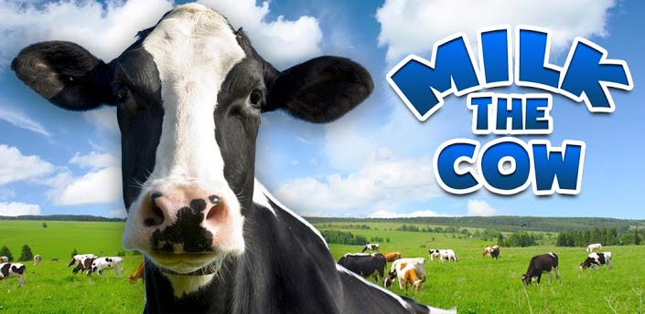
Land Use for Dairy Production in New Zealand

Slide 2
Production Cycle
Read the dairy basics handout and answer the questions on the board to find out about the Dairy production cycle and management.
In 2007 New Zealand had more than 4.2 million dairy cows producing over 15 billion litres of milk.
The national dairy herd was made up of Holstein-Friesian (47%, although declining), Jersey (15%), Ayrshire (2%), and some minor breeds such as Guernsey, Brown Swiss and Meuse Rhine Issel.
http://www.godairy.co.nz/life-on-the-farm/a-year-on-the-farm

Slide 3
Land & Climate

Slide 4
Dairy Future - Sustainability

Slide 5
Economy
NZ Dairy Industry by Numbers | 2011-12
Cows (milking) | 4.6 million (63% in North Island; 37% in South Island)
Number of herds | 11,798
Average herd size | 393
Total effective dairy farmland | 1.64 million ha
Billions of milk litres processed (annually) | 19.1 billion
Export earnings (largest dairy exporter in the world but 8th largest producer – 2.5 % of world dairy production) | $13.7 billion NZ dollars
Share of world trade in dairy products | 36%

Slide 6
Economy

Slide 7
Technology
http://www.teara.govt.nz/en/dairying-and-dairy-products/page-5

Slide 8
Environment
Water Accord
http://www.dairynz.co.nz/file/fileid/47273
http://www.fedfarm.org.nz/publications/media-releases/article.asp?id=856#.UmCBI3BmiSp

Slide 9
Environment
Enviro south effluent guide

Slide 10
Environment
Methane
http://www.dairynz.co.nz/file/fileid/27325

Slide 11
Politics
Dairy cow welfare
https://www.voiceless.org.au/the-issues/dairy-cows

Slide 12
Labour
http://www.godairy.co.nz/life-on-the-farm/a-day-in-the-life
http://www.southernlocal.co.nz/your-southern-farming-resources/seasonal-checklist/seasonal-checklist-october-november

Slide 13
Social
Sharemilking
With the average price of a farm at almost $2 million, plus the cost of cows and dairy-company shares, it is difficult for young people to acquire properties. However, many young New Zealanders have followed the sharemilking route into farm ownership. It begins with practical training as a farm worker, followed by responsibility as a herd manager, and then cow ownership and sharemilking. The farm owner, usually an older and experienced dairy industry operator, offers a contract of one to five years to a sharemilker who owns all or part of the herd, operates the farm, and shares the income. They have equal share of the revenue in the common ‘50% sharemilker agreement’.
Sharemilking allows someone with little money to invest in cows, accumulate expertise and finance, and eventually buy a farm. Some have gone on to buy sheep or beef farms.
New Zealand dairy farms usually have two full-time workers, mostly family members. Sometimes the sharemilker is a son or daughter of the owner, intent on increasing equity so they can pay out siblings and take over the family farm. More than 90% of all New Zealand dairy farms are owned by a family rather than a company or city-based investor. Sharemilkers operate 35% of all farms, allowing owners to step back from hard daily work and concentrate on farm maintenance or other interests.

Slide 14
Social
Opinions about lifestyle and living with uncertainty.
http://www.dairyinfo.biz/images/Content/M5/402Social_Expansion.pdf

Slide 15
SUMMARY
Land Use with Irrigation in New Zealand

Slide 16
SUMMARY
Export NZ$M

Slide 17
SUMMARY

Slide 18
SUMMARY

